Slide 1
The International Classification of Diseases – 11th Revision: The Clinical Perspective
Patrice Forget
Institute of Applied Health Sciences, Epidemiology Group, School of Medicine, Medical Sciences and Nutrition, University of Aberdeen, UK, Department of Anaesthesia, NHS Grampian, Aberdeen, UK.
The European Pain Federation EFIC – Advocacy Chair and The Societal Impact of Pain Platform (SIP) Chair

Slide 3
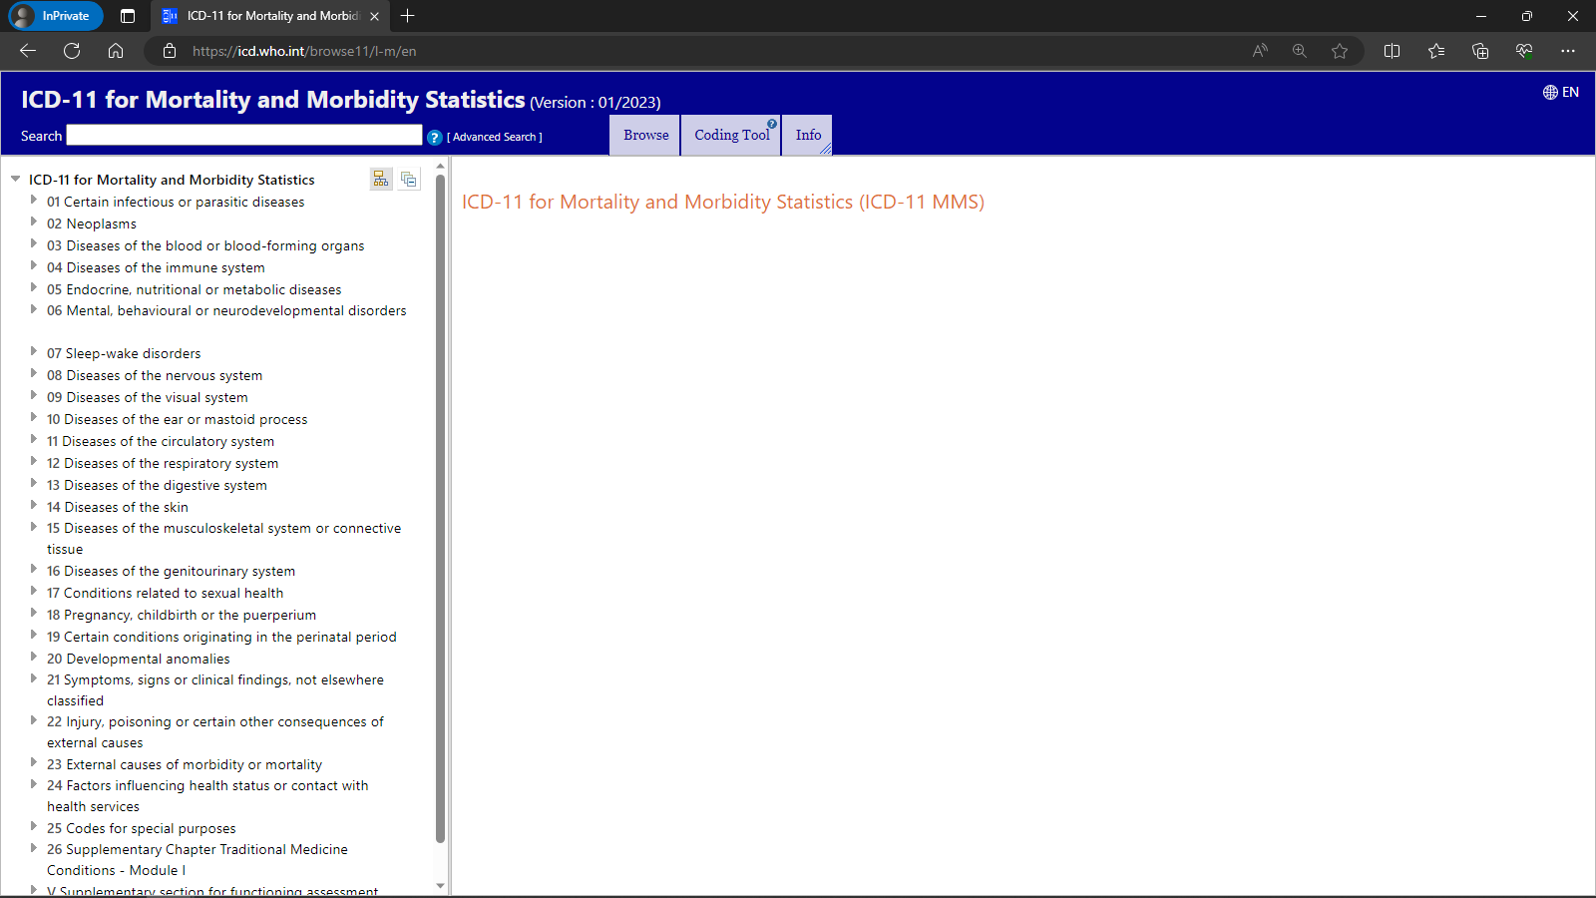

Slide 4
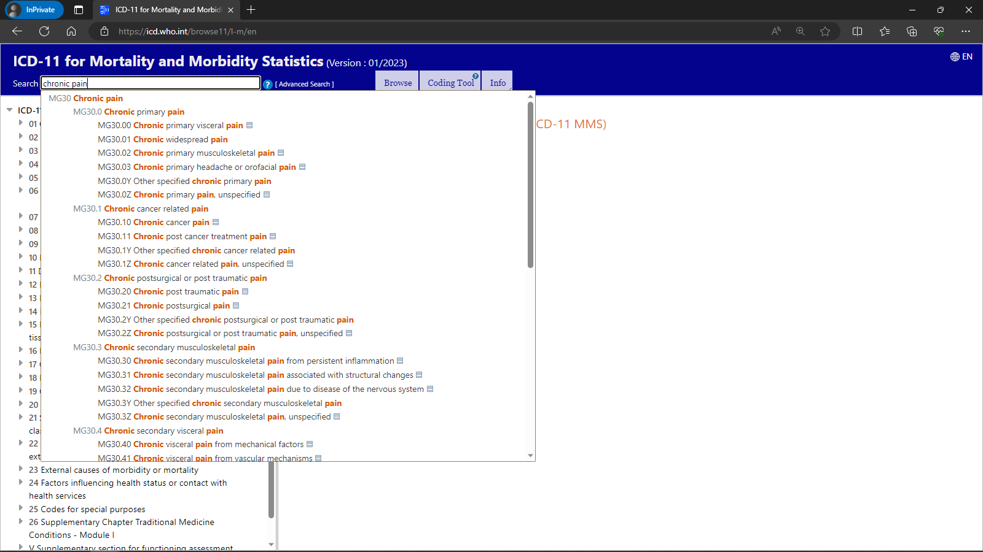

Slide 5
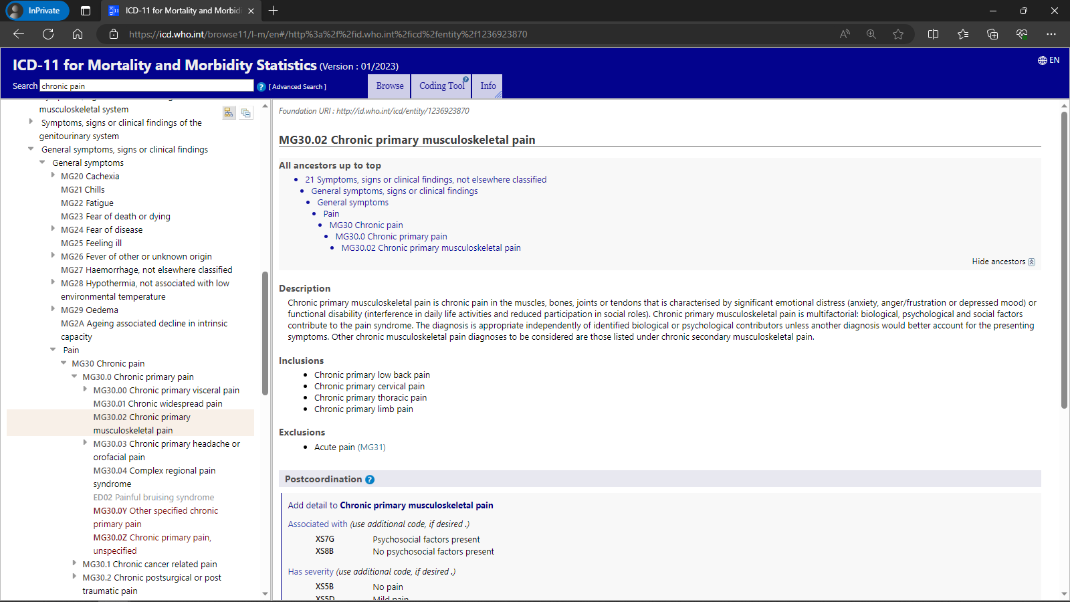

Slide 6
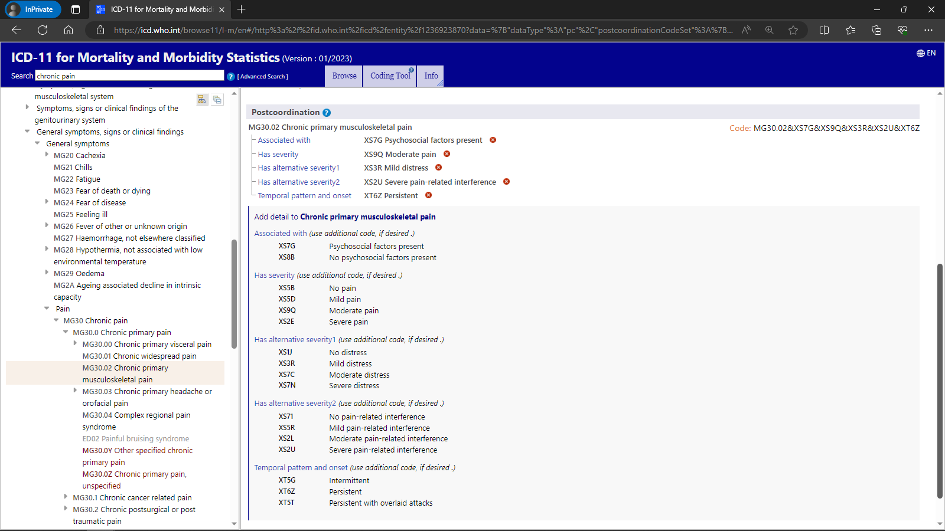

Slide 7
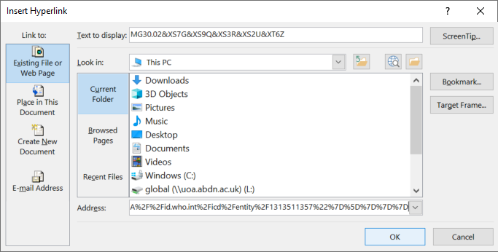

Slide 8
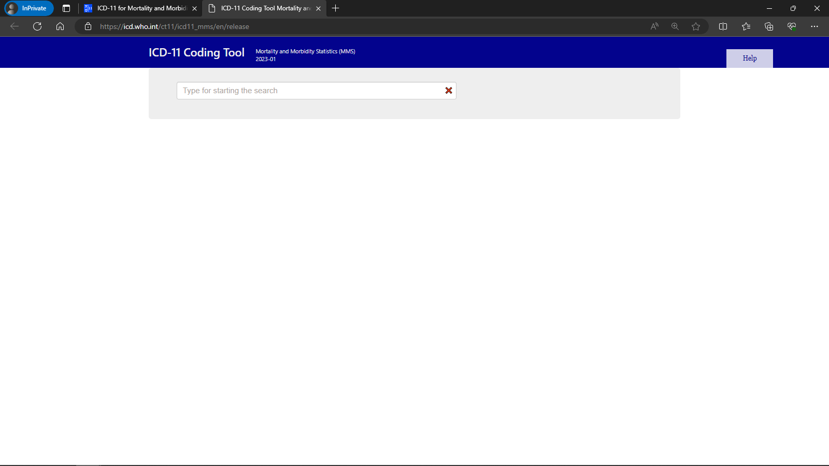

Slide 9
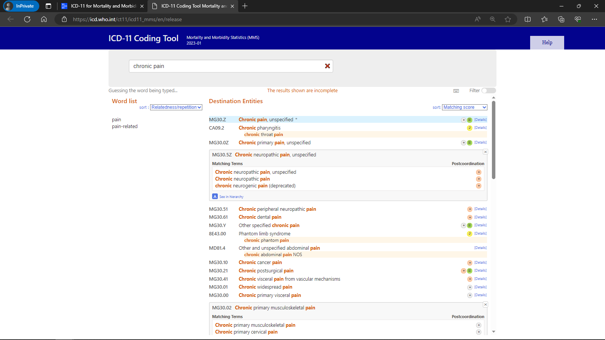

Slide 10
