Slide 1

SIP Stakeholder Forum
16th October 2024
The Societal Impact of Pain

Slide 2
Agenda
Start | End | Title | Who
15h00 | 15H05 | Welcome | JOK & LJ
15h05 | 15h10 | Background on SIP | SK & ACP
15h10 | 15h15 | SIP 2024 Policy Priorities and Updates | SK & ACP
15h15 | 15h45 | SIP National Platforms Roundtable | SIP NPs
15h45 | 16h05 | Reflection on the New EU Health Policy Agenda | ALL
16h05 | 16h25 | Sibling Organisations Case Studies | ECO – RP ESC - JK
16h25 | 16h55 | How are our Partners Approaching the New EU Mandate? | ALL
16h55 | 17h00 | Next Steps and Closure | JOK &LJ

Slide 3
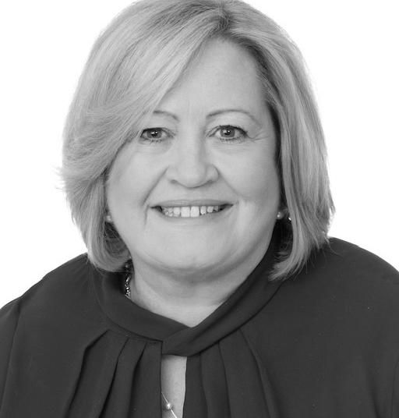
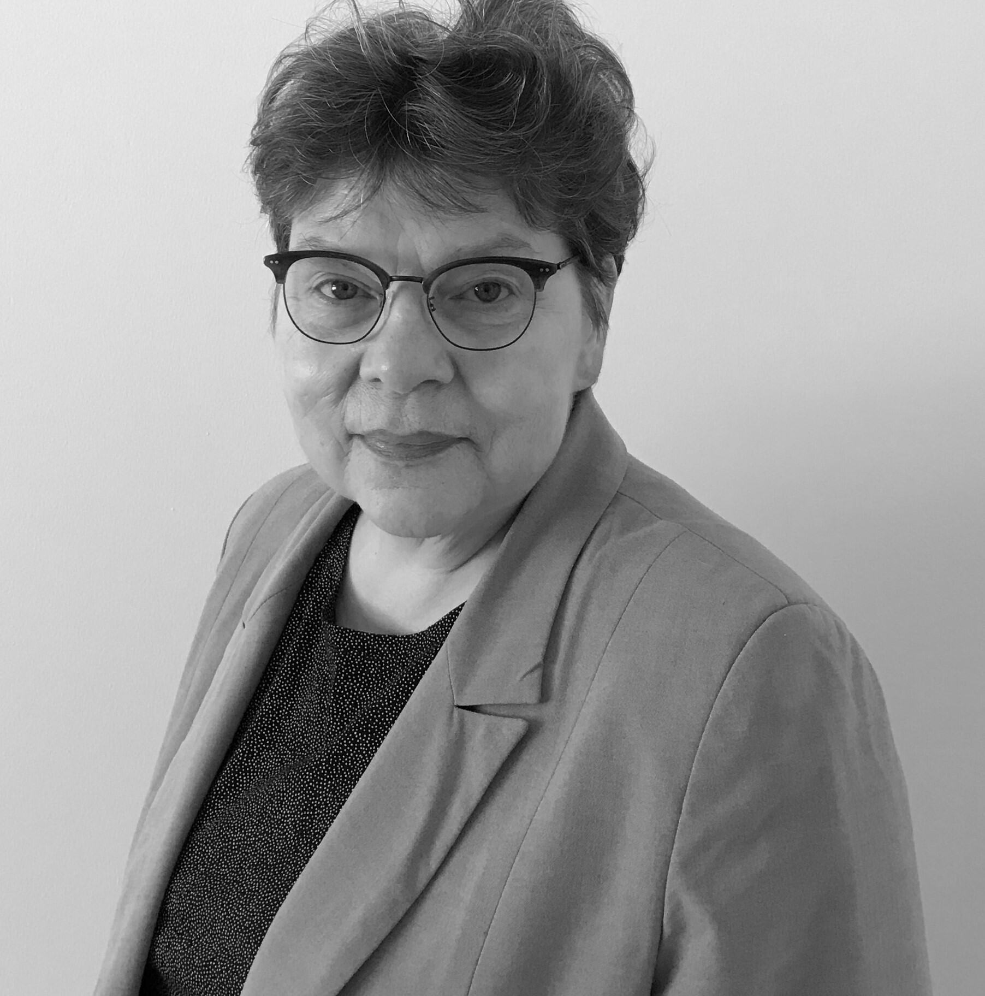
Welcome
Joanne O’Brien Kelly
EFIC Executive Board Member Advocacy Committee Co-Chair
Liisa Jutila
SIP – Co-Chair
PAE Board Member

Slide 4
The Societal Impact of Pain
The ‘Societal Impact of Pain’ (SIP) platform is a multi-stakeholder partnership led by the European Pain Federation EFIC and Pain Alliance Europe (PAE), which aims to raise awareness of pain and change pain policies.​
​
The platform provides opportunities for discussion for health care professionals, pain advocacy groups, politicians, healthcare insurance providers, representatives of health authorities, regulators, and budget holders.​
​
The scientific framework of the SIP platform is under the responsibility of EFIC, and the strategic direction of the project is defined by both partners. The pharmaceutical companies Grünenthal GmbH and GSK are the main sponsors of the Societal Impact of Pain (SIP) platform.​
​

Slide 5












SIP National Platforms
Notes:
The SIP National Platforms are comprised of healthcare professional / scientific and patient representative bodies from all over Europe with an interest in pain, and there are several SIP National Platforms across Europe.
This year we have two additional new Platforms: Sweden and Germany.

Slide 6
SIP Objectives
Raise awareness of the relevance of the impact that pain has on our societies, health and economic systems​
​
Exchange information and share best practices across all member states of the European Union​
​
Develop and foster European-wide policy strategies & activities for an improved pain care in Europe

Slide 7
SIP Long-Term Priorities
Pain as an indicator: Develop instruments to assess the societal impact of pain (pain as a quality indicator).​
Pain education: Prioritise pain education for health care professionals, patients, policymakers and the public.​
Pain in employment: Initiate policies addressing the impact of pain on employment and include pain in relevant existing initiatives.​
Pain research: Increase investment in research on the societal impact of pain.

Slide 8
SIP 2024 Priorities
Digital Health
ICD-11
Mental Health
Access to Treatment

Slide 9
Digital Health/ICD-11 – European Health Data Space
Digital Health
&
ICD-11
Position Papers
Inclusion of ICD-11 in EHDS EP Report
Inclusion of ICD-11 in EHDS Joint Text
Inclusion of ICD-11 in EHDS EP Report
Political Engagement at EU and National Level
ICD-11 Letter to the Editor on the European Journal of Pain
Translation of Digital Health & ICD-11 Position Papers and materials

Slide 10

European Health Data Space
The Joint Text was approved by the European Parliament on 24th April, and the Council of the European Union will do the same in October 2024.
An International Classification Coding system for diseases is included within the Joint Text, as part of ‘Annex 1; Main characteristics of priority categories of personal electronic health data for primary use; Patient Summary’. Stating ‘An International Classification Coding’ to classify ‘Current, resolved, closed or inactive problems’ within patient summaries. This is a step in the right direction which will hopefully support the national roll-out of the International Classification of Diseases – 11th Revision.

Slide 11
Mental Health
Letter to the Editor on Pain and Mental Health - Epidemiology and Psychiatric Sciences
Inclusion of pain and related topics in Mental Health EP Report
Pain and Mental Health Workshop at #EFIC2025
Pain and Mental Health Joint Statement
Translation of Pain and Mental Health Joint Statement and materials
Political Engagement at EU and National Level
EU Parliament Pain and Mental Health Event in October 2023

Slide 12
Access To Treatment
SIP Book of Evidence on the Burden of Pain – 6 MEPs endorsers
Translation of SIP Book of Evidence on the Burden of Pain
SIP Policy Framework on the Delivery of Pain
The Burden of Pain National Case Studies
Political Engagement at EU and National Level
Infographics on SIP Book of Evidence on the Burden of Pain
Access To Treatment Event on 16th October 2024

Slide 13
SIP National Platform Roundtable

Slide 14

Updates for 2024
Policy priorities 2025

Slide 15

Societal Impact of Pain Portugal – SIP PT
3 Axes:
RESEARCH
EDUCATION
SIP Priorities
ACTION
Pain as an indicator
Pain education
Pain in employment
Pain research

Slide 16
BACKGROUND

Slide 17
Societal Impact of Pain Portugal – SIP PT
History
SIP PT is an integral part of SIP EU, since 2018 in a partnership between the Portuguese Association for the Study of Pain (APED), 11 founding Patient Associations and Grunenthal PT.
Thus, SIP PT is made up of Health Professionals, being APED the scientific responsible, and Patient Associations who work together in order to reduce the social impact of pain in Portugal, bringing science and society into the same field.
SIP PT is supported by sponsors and brings together other partners (Scientific Societies and Associations) that identify with its objectives.
Para mais informações consulte o site da SIP PT: https://sip-pt.pt/

Slide 18



Societal Impact of Pain Portugal – SIP PT Objetives
Raise awareness about the relevance of the impact of pain on people, family, health/economic systems and society in general
Exchange information and share best practices across all member states of the European Union on the scope of SIP Europe
Develop and promote national political strategies and activities for better pain management in Europe
Para mais informações consulte o site da SIP PT: https://sip-pt.pt/

Slide 19
Societal Impact of Pain Portugal – SIP PT
Governance
SIP PT has a Governance Model approved in 2021 by SIP EU and updated in 2024. SIP PT is managed by an Executive Committee (EC) whose operating document was approved by Members in 2021 and reviewed in 2022.
The EC works with volunteers: one delegate from APED and four representatives from Patient Associations.
Para mais informações consulte o site da SIP PT: https://sip-pt.pt/

Slide 20
Societal Impact of Pain Portugal – SIP PT
Governance
The EC is responsible for the day-to-day management of the Platform, serving as its public face and the point of contact for policymakers/stakeholders/ sponsors/other organizations.
SIP PT is supported by sponsors and brings together Members (Patient Associations) and Partners (Scientific Societies and Associations) that identify with its objectives.
Para mais informações consulte o site da SIP PT: https://sip-pt.pt/

Slide 21
ACTION: updates for 2024

Slide 22
Societal Impact of Pain Portugal – SIP PT
2024
New EC Members
New Governance Model
Translation of SIP EU Documents
Update of the website https://sip-pt.pt/
History/Objetives, SIP PT, SIP EU, Campaignes, Resources
ACTION: webinar “Pain Voice” 14th June
25 years of the First National Day Against Pain
Para mais informações consulte o site da SIP PT: https://sip-pt.pt/

Slide 23
Societal Impact of Pain Portugal – SIP PT
END 2024
Awareness letter “SIP PT Reflexion” about what policies are needed for better pain management in Potugal aimed to Policymakers/ Health Organizations/ Social Organizations/ Political Parties/ national and european portuguese Deputies.
“SIP PT Reflexion”
  Prevalence of Pain in Portugal and its Impact on Health
  Economic Impact of Chronic Pain
  Chronic Pain and Employment
  Pain and Mental Health
  Implementation of ICD-11 and Chronic Pain
  Digitalization of Pain Assessment and Quality Indicators
  Health Policies Related to Pain
Para mais informações consulte o site da SIP PT: https://sip-pt.pt/

Slide 24
Societal Impact of Pain Portugal – SIP PT
END 2024
Active dissemination of translated Documents
Stakeholders meeting
Survey online “Pain and Employment”
Para mais informações consulte o site da SIP PT: https://sip-pt.pt/

Slide 25
ACTION: policy priorities 2025

Slide 26
Societal Impact of Pain Portugal – SIP PT
2025 Priorities
Research Project on “Pain and Employment”
University Partnership/Stakeholders
Advocacy to captivate new Members and Partners
Patient Associations / Scientific Societies/ Health and Social
Organizations
Dissemination of translated Documents
A second Guide for Pain Medicine Consultations
Para mais informações consulte o site da SIP PT: https://sip-pt.pt/
=======

Slide 27

THANK YOU

Slide 28

SIP BELGIUM

Slide 29
Launch of the SIP Belgium national platform
First SIP Belgium steering committee meeting
New leadership – Omer Van Haute
New leadership - André Mouraux & Pijnpunt
First stakeholders meeting September 13th 2024
Next stakeholders meeting January 24th 2025
HISTORY
2018
2019
2021
2024

Slide 30
SIP BE is a national multistakeholder platform whose aims are:
(1) to reduce the number of people suffering from pain through the implementation of better pain prevention strategies
(2) to improve the quality of life and function of people living within pain through the implementation of better pain management in Belgium.
MAIN GOALS

Slide 31
(1) Advocate for improved education and awareness of pain and its societal impact.
(2) Advocate for the use of pain as a health quality indicator, and the need for quantitative data that would allow monitoring the prevalence and societal impact of pain.
(3) Advocate for improved and timely access to care for patients with pain by integrating specialist pain management services into a coordinated network that includes first-line healthcare professionals.
SPECIFIC GOALS

Slide 32


Ireland

Slide 33
National Pain Prevelance
Chronic pain is estimated to affect 13-36% of the Irish population
33.4% of those with chronic pain reported a HADS-D score of >8
37% of those with chronic pain were moderate to severely disabled by their pain
Total cost per annum of all chronic pain patients amounted to €5.3bn or 2.2% of national GDP.

Slide 34
Chronic Pain Services
Ireland operates as a government funded public healthcare system which is administered by a state-run organisation known as the Health Service Executive (HSE)
Nursing -0.67 WTE per 100,000
Physiotherapy - 0.2 WTE per 100,000
Psychology - 0.16 WTE per 100,000
16 hospitals operate a chronic pain management service
11,932 new referrals on OPD waiting list
3034 waiting >18 months
27 consultants which equates to 0.55 consultants per 100,000 capita
3496 on pain procedure waiting list
196 waiting > 18 months

Slide 35
2024 agenda
Ireland
Re-established in 2024 with representation from Chronic Pain Ireland and Irish Pain Society
Actively seeking representation from other organisations with an interest in chronic pain to develop a key stakeholder forum
Taking guidance from other national platforms on how to establish the Irish SIP platform

Slide 36
2025 Priorities
Ireland
National Model of Care in development - Once established the Irish SIP platform will identify how model may be utilised to support platform needs
This will guide how the SIP book of evidence can be utilised to support requests for additional supports for the Irish Chronic Pain Population and services
Identify national platform priorities to facilitate future planning

Slide 37
Thank You

Slide 38


Update on SIP Malta
Gertrude Buttigieg
October 2024

Slide 39
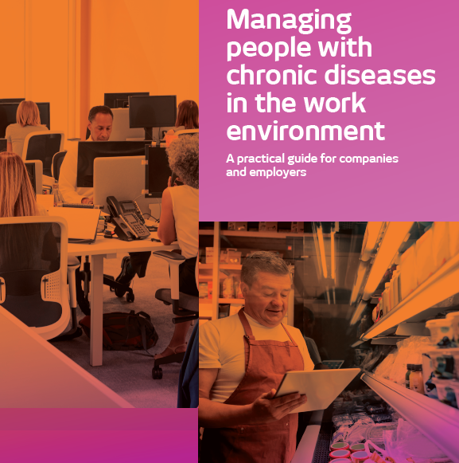

2023
The Malta Health Network (MNH) together with the lead partners Platform of Patient Organizations (POP), organizations that represent people with chronic disease in Spain and Malta respectively, have prepared the Guide “Managing people with chronic diseases in the work environment’ with the aim of giving visibility to the situation of people living with a chronic disease, including chronic pain and contributing to their full labour and social inclusion. This project was carried out with funding from Erasmus Plus Programme.

Slide 40

2024 Thanks to Funding through the Voluntary Organisations Projects SchemeVOPs(2023) produced 5 videos
2 in Maltese
3 in English
Patient Empowerment Self-Management
Professional-Patient Communication

Slide 41














Thank you very much!
www.maltahealthnetwork.org

Slide 42
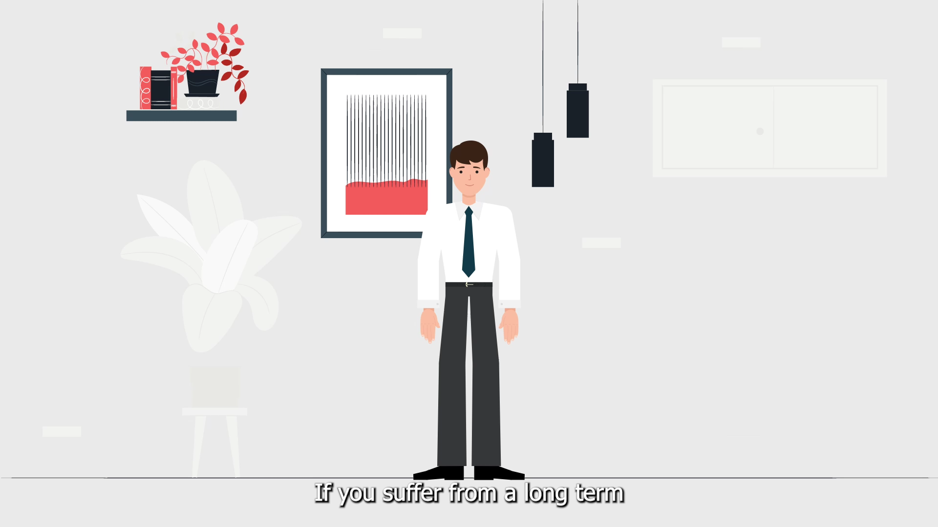
Notes:
VIDEO

Slide 43


Denmark - FAKS - The association of chronic pain afflicted
PRESENTING POLICY PRIORITIES AND UPDATES FOR 2024/2025
SIP - STAKEHOLDER FORUM 2024
www.faks.dk

Slide 44


THE DANISH GOVERNMENT
WILL MOVE THE HEALTHCARE SYSTEM CLOSER
WITH A LARGE AND NEW REFORM
Update: In the reform plan 'Health close to you', the government plans to change both the structure, the distribution of tasks and the economy. The goal is to strengthen and future-proof the overall healthcare system.
More and more people (with chronic conditions) are needing care and treatment across hospitals, general practice and municipal healthcare services . Currently, there is a lack of coherence in the trajectories of health interventions. Part of the plan is introducing e.g. new treatment plans and packages for people living with chronic disease (similar to cancer treatment).
Activity: FAKS is positive with the focus and prioritization of more resources invested in chronic conditions - but we are also concerned about 'one size fits all'. FAKS has been active in e.g. radio debates on the topic and will continue to ‘knock’ on doors to ensure patient engagement in the coming debates.
SIP - STAKEHOLDER FORUM 2024
www.faks.dk

Slide 45

PROPOSAL FOR THE ESTABLISHMENT OF A NATIONAL CLINICAL QUALITY DATABASE FOR CHRONIC PAIN.
Purpose: Formally including chronic pain in the Danish clinical quality development program has the potential to not only contribute to better treatment, but also increase documentation and health political awareness.
Update: There is continued political focus on chronic pain, a National Coordination Forum has been set up in the area of ​​pain, there is the “Choose Wisely”-campaign in relation to opioid treatment, new guidelines and recommendations are drawn up from SST, work has previously been done on the development of indicators for quality in collaboration with FAKS, clinicians and managers across the interdisciplinary pain centers in DK.
Partners:
FAKS
Henrik Bjarke Vægter, PT, MSc Pain Management, ph.d. Pain Research Group / Pain Center (Smertecenter Syd, OUH)
Danish Pain Society
Support from national pain clinics
SIP - STAKEHOLDER FORUM 2024
www.faks.dk

Slide 46
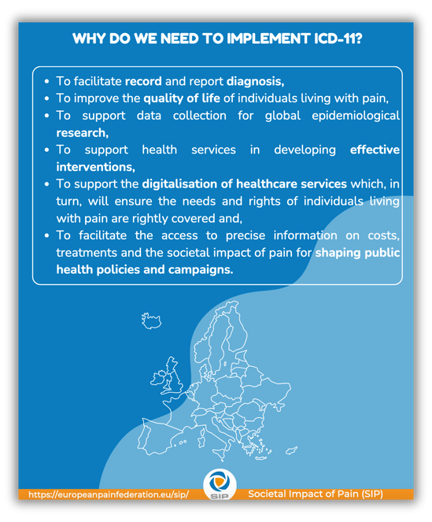
ICD-11 IMPLEMENTATION HAMPERED BY THE REGIONS
Purpose: Add awareness and political pressure to switch (faster) to ICD-11.
Update: The Danish Health data authority is (which has been given the responsibility of implementation) well underway with preparations to switch to ICD-11. Unfortunately, the Danish Regions have expressed that they do not see the implementation of ICD-11 as a high priority for the development of the Danish healthcare system right now.
They recognize the need to switch to ICD-11 in the long term and our international obligations, but they do not see immediate benefits in relation to the complexity and cost of adopting ICD-11.
The field of psychiatric society has managed to make enough noise, so that the regions will implement that field first. FAKS has been in contact with the Health data Authority and has sent an inquiry to the Danish Regions.
Related topic: Chronic primary pain as functional disorder can put a spanner in the works of ICD 11.
SIP - STAKEHOLDER FORUM 2024
www.faks.dk

Slide 47

THE PIXIBOOK OF CHRONIC PAIN
Purpose: The pixibog is a model that in the format of video, print and digital book in a simple way explains chronic pain.
Update: Chronic pain can be difficult to wrap your head around.
A biomedical paradigm tend to influence our understanding.
Even doctors and other health professionals can have a hard time to break away from and dualistic understanding where lack of pathology is automatically interpreted as psychologic cause and vice versa.
SIP - STAKEHOLDER FORUM 2024
www.faks.dk

Slide 48

LACK OF CROSS SECTORAL EFFORTS AND COORDINATION
Background & relevance: The bio-psycho-social complexity of chronic pain calls for efforts in both the health-,the social- and employment area. Not least coordination and coherence of legislation. Both The Danish authority of social services and The Danish agency for labor Market and recruitment were invited as part of the commission and the work of national pain plan. However, none of them prioritized participation.
Activity: FAKS reached out to them and the responsible ministries flagging the importance of a coordinated effort. Both of them more or less replied that the pain area is primarily part of The Danish Health Authority's area of ​​responsibility, not theirs.
This contradicts with the recommendations themselves stating a need for greater interdisciplinary and cross-sectoral work.
SIP - STAKEHOLDER FORUM 2024
www.faks.dk

Slide 49

CHRONIC PAIN ON THE AGENDA (MEDICIN.DK)
Chronic pain on the agenda (Medicin.dk)
Activity: FAKS shared the patient’s perspectives and experiences at a meetinA targeting healthcare professionals who frequently encounter patients with chronic pain.
Approximately 200 healthcare professionals attended including doctors, nurses, pharmacists, and physiotherapists.
SIP - STAKEHOLDER FORUM 2024
www.faks.dk

Slide 50
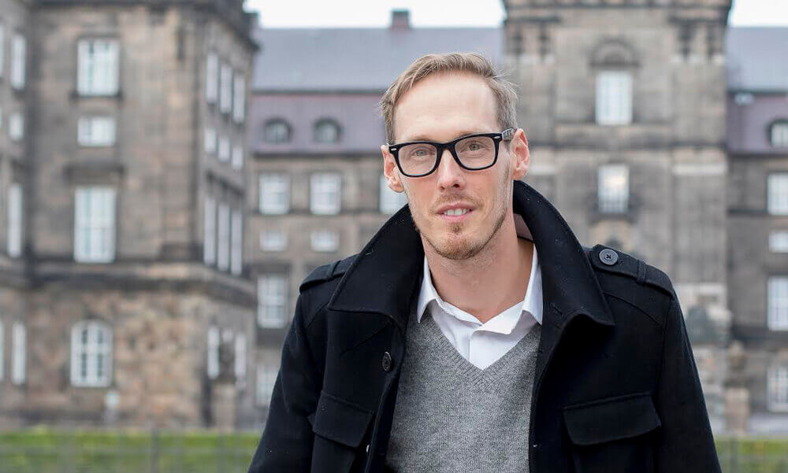
FAKS’ LARS BYE MØLLER RECEIVES NOMINATION FOR “RECOMMENDED PATIENT OF THE YEAR IN RESEARCH 2024”
Professor of pain at the multidisciplinary pain center Odense university hospital's (OUH) Henrik Bjarke Vægter has recommended Lars Bye Møller to "Patient of the Year in Research".
In FAKS we have been involved in a partnership with the pain research group at Smertecenter Syd, OUH under the Research Unit for Anesthesiology at SDU.
In FAKS we use a lot of the patient association's resources to collaborate with researchers and health authorities.
SIP - STAKEHOLDER FORUM 2024
www.faks.dk

Slide 51


MORE RESTRICTED ACCESS TO OPIOID THERAPY
Background/relevance: Opioids have been increasingly criticized for being counterproductive in the treatment of chronic non-malignant pain. Increased journalistic and health political focus on what is presumably a rising misuse of addictive medication among young people. A number of pain patients find themselves in a bind when their doctor no longer wants to prescribe their medication.
Topic for discussion: The question is therefore whether it is possible to reduce the consumption of opioids overall while not stigmatization and hindering access to pain medication those individuals where the therapeutic benefit outweighs the side effects.
Activities:
  FAKS is trying to be vocal and endorse a more balanced approach to opioids as the media often go with the most sensational stories lacking the perspective that medication can actually help some people in short or longer term when all other options have been exhausted.
  FAKS is part of a working group with The National health authorities making new national clinical recommendations for pharmacological treatment of pain.
  .Faks has been invited to participate in working group of the Capital Region working on more rational use of opioids
  FAKS participated in meeting held by The organization Choose Wisely and Danish Health Authority.
SIP - STAKEHOLDER FORUM 2024
www.faks.dk

Slide 52

CHRONIC PRIMARY PAIN AS FUNCTIONAL DISORDER CAN PUT A SPANNER IN THE WORKS OF ICD 11
Background/Relevance: Interchangeable use of the diagnosis chronic complex/primary pain and functional disorder in Denmark. The clinical decision of diagnosing in many cases seems to depend more on the speciality and the physician rather than the patient and the symptoms. Thus, in 2019 specific codes for functional disorders were implemented in the Danish hospital service classification system. urging clinicians to prioritize this diagnosis over chronic complex pain. Therefore, despite the possibility of multiple parenting, we fear that the competing practice in Denmark and potentially other countries will put a spanner in the works of a more systematic registration and documentation of chronic pain according to ICD-11. The diagnosis “functional disorder” is not covered by treatment guarantee and the waiting times are substantial.
Activities:
FAKS submitted a long letter and inquiry to EFIC and PAE “functional disorder as a competing diagnosis for chronic primary pain“. However it seems there is an air of avoidance to bring the topic forward.
FAKS has also been in an ongoing dialogue and meetings with the Danish Society of functional disorder and The clinic of functional disorder in the central region.
Question:
Where do SIP stand on the use of functional disorder and demarcation between functional disorder, and primary pain ( both are mentioned in the book of evidence) ? Is it something we are taking a position on?
SIP - STAKEHOLDER FORUM 2024
www.faks.dk

Slide 53

QUESTION & RECOMMENDATION FROM FAKS
1.In the other national platforms, what is the extent of Involvement and collaboration with national EFIC Chapters of healthcare professionals?
In Denmark we have various times reached out to the Danish Pain Society and also done some collaborations. However, it is difficult to establish continuous communication and collaboration. Some probably due to the lack of resources and some due to their reservations of being ‘tied’ to patient organizations.
Question:
Does SIP provide any support in this context?
2.Putting into use the SIP Book of Evidence Case Study Template for the Societal Impact of Pain (SIP).
Recommendation:
SIP needs to put time and effort into consolidating and anchoring the national platforms' understanding and use of material - FAKS believes simply distributing them is not enough (national workshops etc.)
SIP - STAKEHOLDER FORUM 2024
www.faks.dk

Slide 54

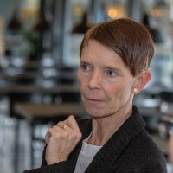
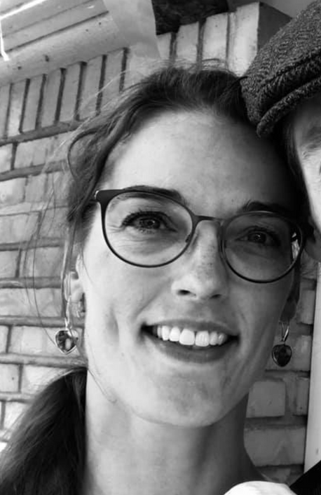

THANK YOU FROM FAKS, DENMARK
Iben Rohde
Lars Bye Møller
Sanne Lydø
Mathilde Kehler
SIP - STAKEHOLDER FORUM 2024
www.faks.dk

Slide 55


Slide 56
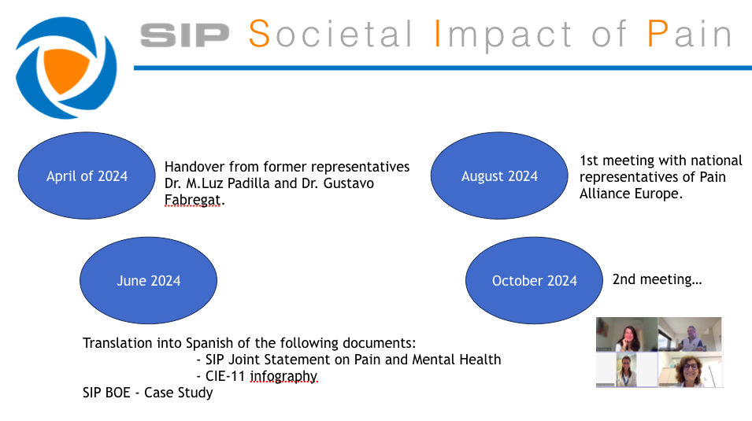

Slide 57
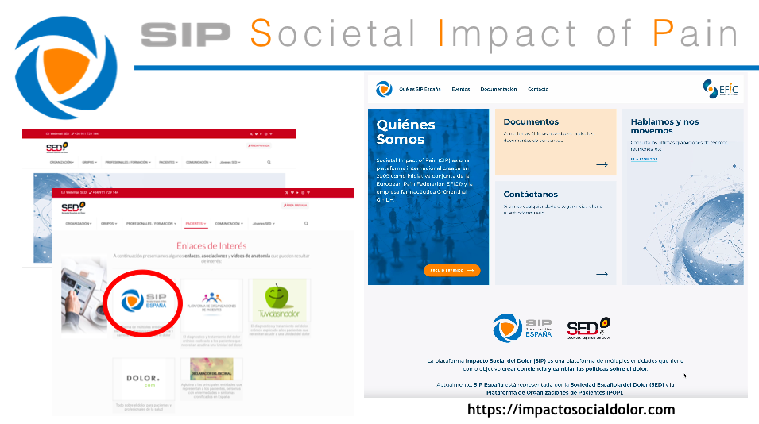

Slide 58
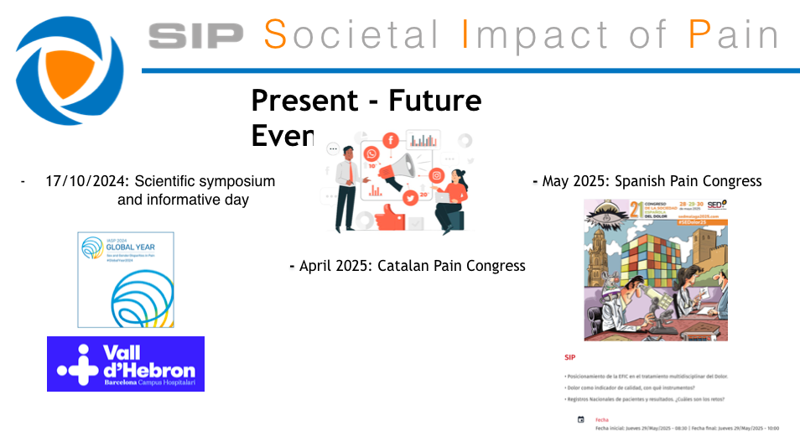

Slide 59
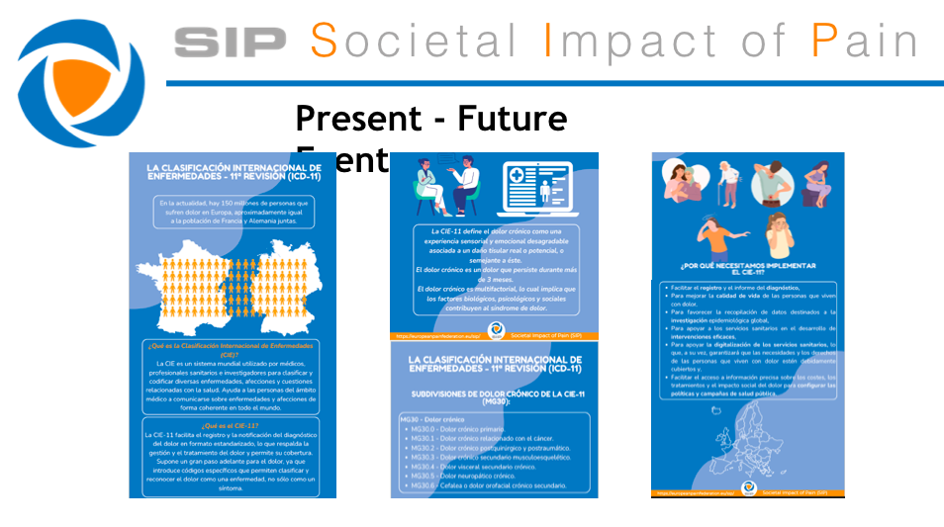

Slide 60


Slide 61


SIP Sweden - activities 2024
Preliminary steering committee and structure has been formed
Anna Bjarnegård Sellius, President Swedish Pain Society
Paulin Andréll, Vice president Swedish Pain Society
Monika Löfgren, Representative for the Swedish Quality Registry for Pain Rehabilitation
Gunilla Göran, Board member of the Swedish Rheumatism Association
Swedish Pain Society will be the responsible association for SIP Sweden

Slide 62
SIP Sweden - activities 2024
Digital start-up meeting for SIP Sweden was performed June 13th
President for associated professional organizations (n= 7)
President for patient associations (n= 6)
Introduction to SIP Europe and SIP Sweden
A task force for planning the SIP Sweden workshop was formed

Slide 63
SIP Sweden - planned activities 2024-2025
Workshop for associated professional organizations and patient associations November 29th
Aim of the workshop:
Establish a steering committee for SIP Sweden
Establish goal for SIP Sweden and define key areas of focus
Appoint a task force for planning the SIP Sweden kick-off in March 2025
The steering committee will after the workshop continue the work to form SIP Sweden by:
Establish a national governance plan for SIP Sweden
Initiate work to identify sponsors for SIP Sweden
Initiate work to create a digital platform for SIP Sweden

Slide 64
SIP Sweden - planned activities 2024-2025
Swedish Pain Society’s education day March 21st 2025
“Kick-off” for SIP Sweden
Members in Swedish Pain Society and patient associations in SIP Sweden
Presentations of goals and national governance plan for SIP Sweden
Workshops based on the defined key areas of focus for SIP Sweden 2025-2027

Slide 65

Dutch EFIC chapter
Highlights 2024
Prof dr André P. Wolff, co-chair

Slide 66
Milestones History
Dutch Chapter of the IASP/EFIC:
1975 – 2025: 50 Years
NVBP 1975-2007
Chapter IASP only MDs as members
Dutch Pain Society 2007-2016
Chapter IASP with multidisciplinary members
PA!N: Pain Alliance in the Netherlands 2017-current
Chapter IASP with delegated chairs of scientific societies and patient organisations fully integrated!!

Slide 67
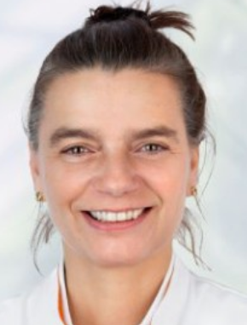
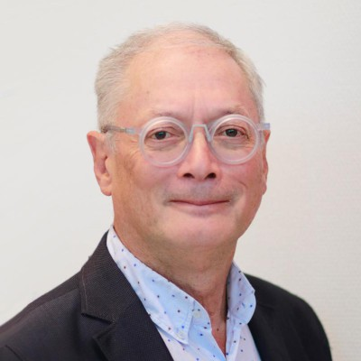
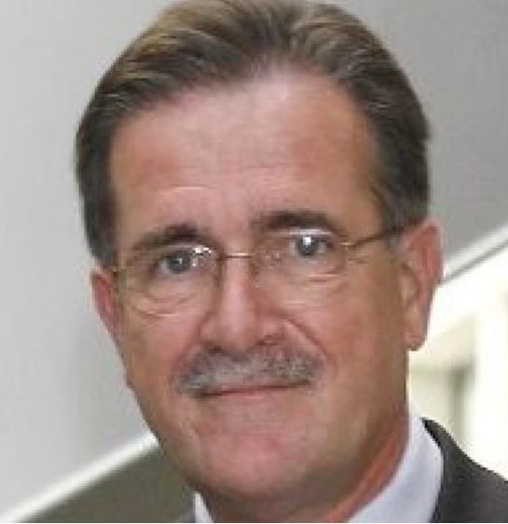
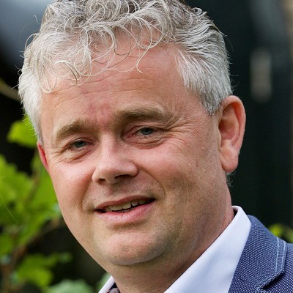
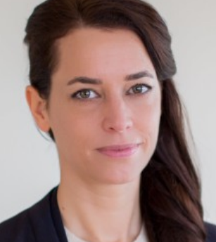
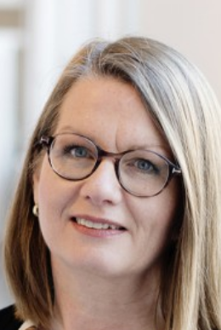
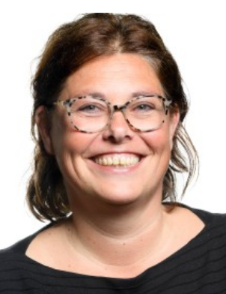
Current Daily Board of PA!N
Prof. dr. M. Steegers Prof. dr. A. Wolff Mr. L. de Both
Chair co-Chair patient organisation
B. Engelsma dr. B. Brouwer Ms. M. Giesberts dr. M. van Beugen

Slide 68
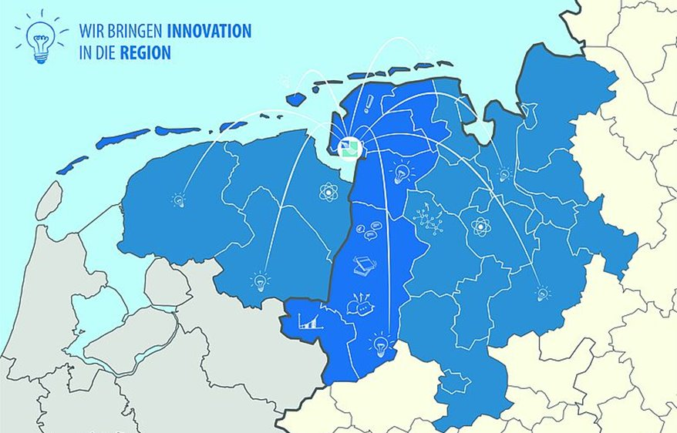
National PA!N programme
Priorities 2024-2025
Education/public campaigns
  Website PA!N
  Dutch Journal for Pain and Pain Medicine
  LAC Amsterdam (IASP): IMPACT PAIN
  Support INTERREG: Pain in the Ems Dollard Region
    €2.5ML project
    Cross border accessibility to pain care
  Yearly pain congress
Network collaboration
  Care Standard Pain ongoing implementation
  Multidisciplinary Guideline ‘Organization and Working Process Chronic Pain ‘
  Bottlenecks & recommendations
      Organization chronic pain care; Examples care pathways; network & communication
      Improving support ‘first line line care’; coordinator
      Scaling up & down care
  Support INTERREG: Pain in the Ems Dollard Region

Slide 69
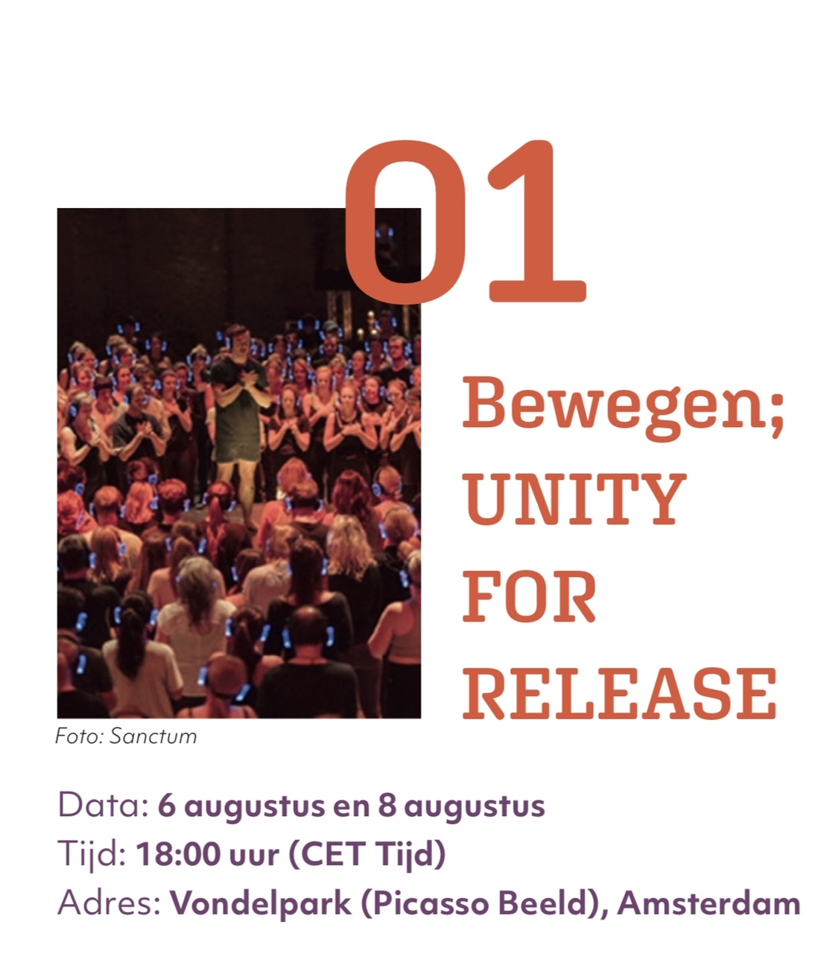


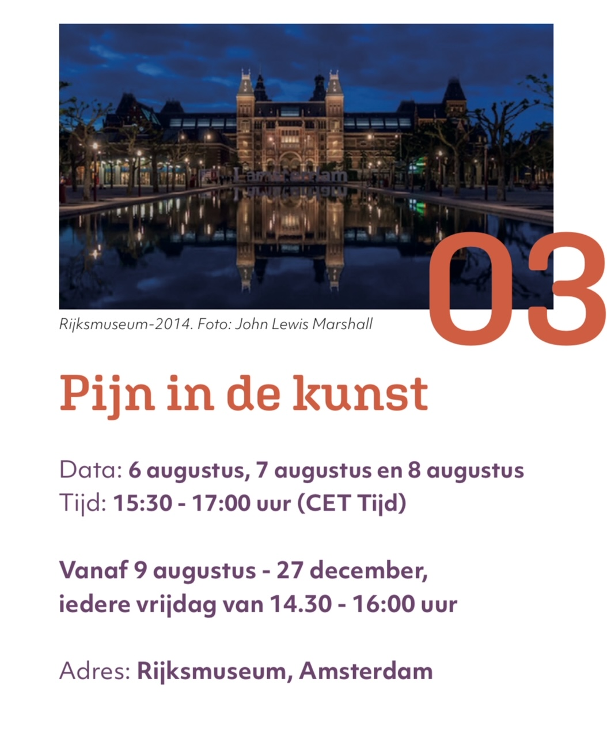
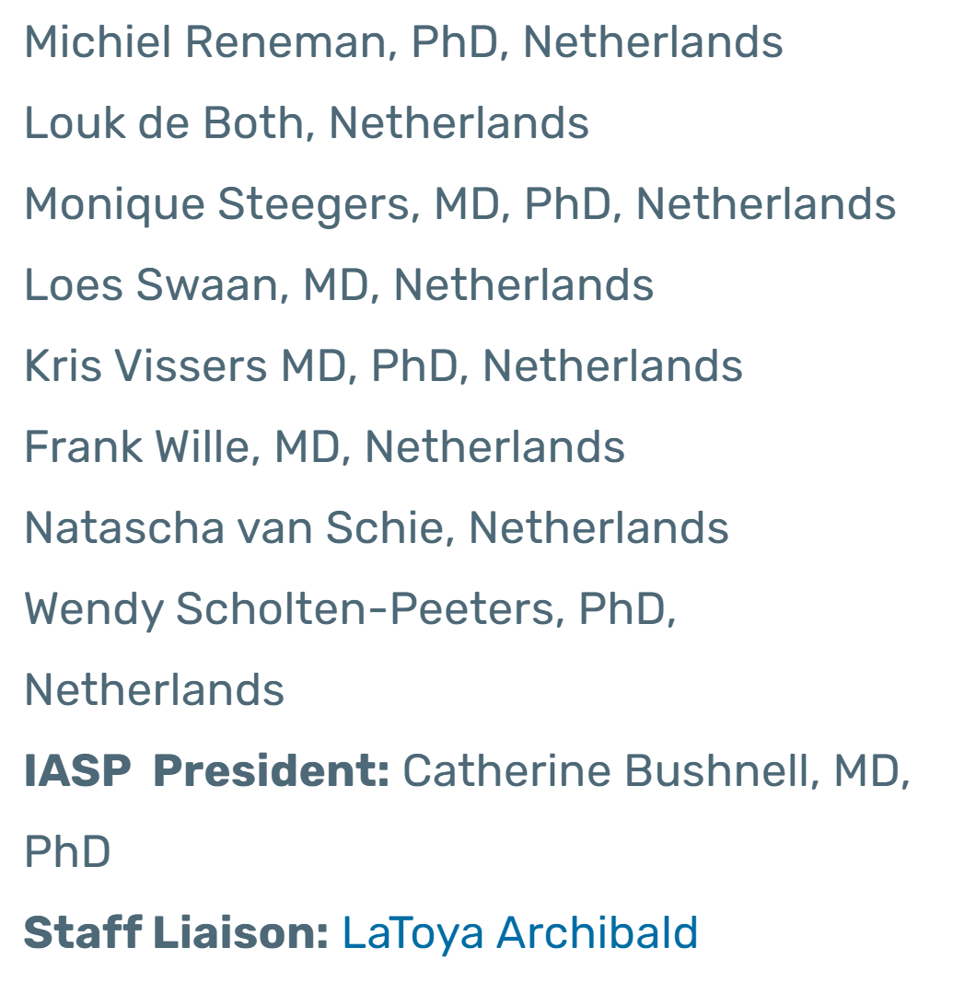
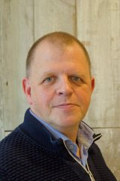
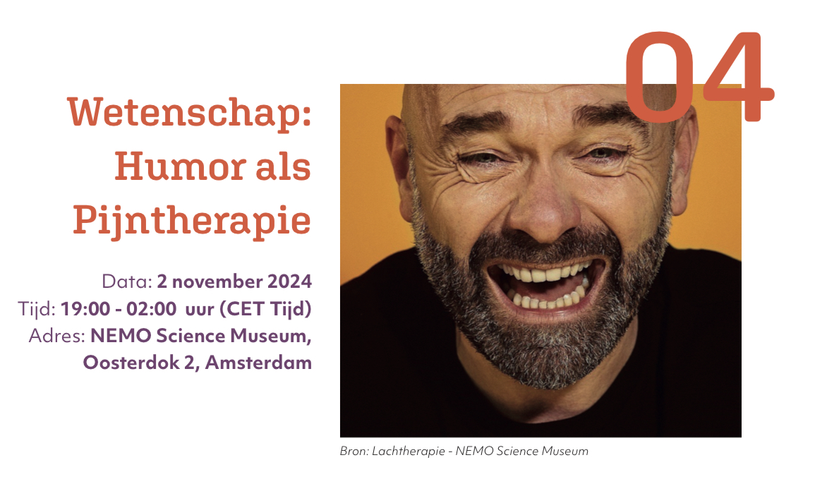
Local Arrangements Committee
Pain Impact programme
dr. H. Timmerman
LAC coordinator

Slide 70
A cinematic journey along the complex and multidimensional nature of pain
Yearly multidisciplinary congress, 16 December 2024
The historical perspective of pain (Prof. dr. Javier Moscoso)
Addiction (Prof. Arnt Schellekens)
Phenotyping:
Pharmacological (Prof. Liesbeth de Lange)
Immunological (Dr. Niels Eijkelkamp)
Small fiber neuropathy (Prof. Karin Faber)
Succes factors for collaboration in persisting complaints (Prof. Judith Rosmalen)
rTMS Neuropathic for pain treatment (Dr. Nadine Attal)

Slide 71
2nd conference: ‘Together on the move to matching pain care’
4 november 2024
PA!N
  Pain taskforce
    National Care Institute
      patient organizations
        Dutch Care Authority
          professional organizations
            scientific organizations
              Insurances
                Regional collaboration initiatives

Slide 72

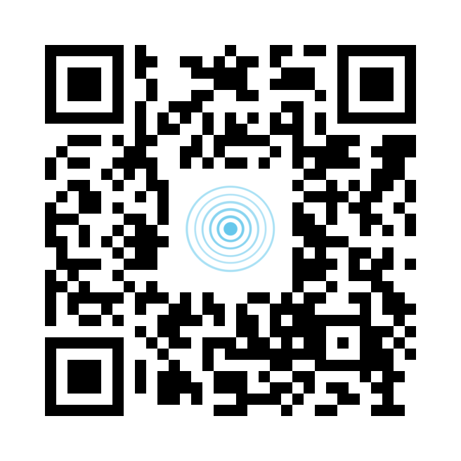
Donate to the Dutch Pain Foundation!
A lot small donations
Give big Research & Education possibilities!

Slide 73
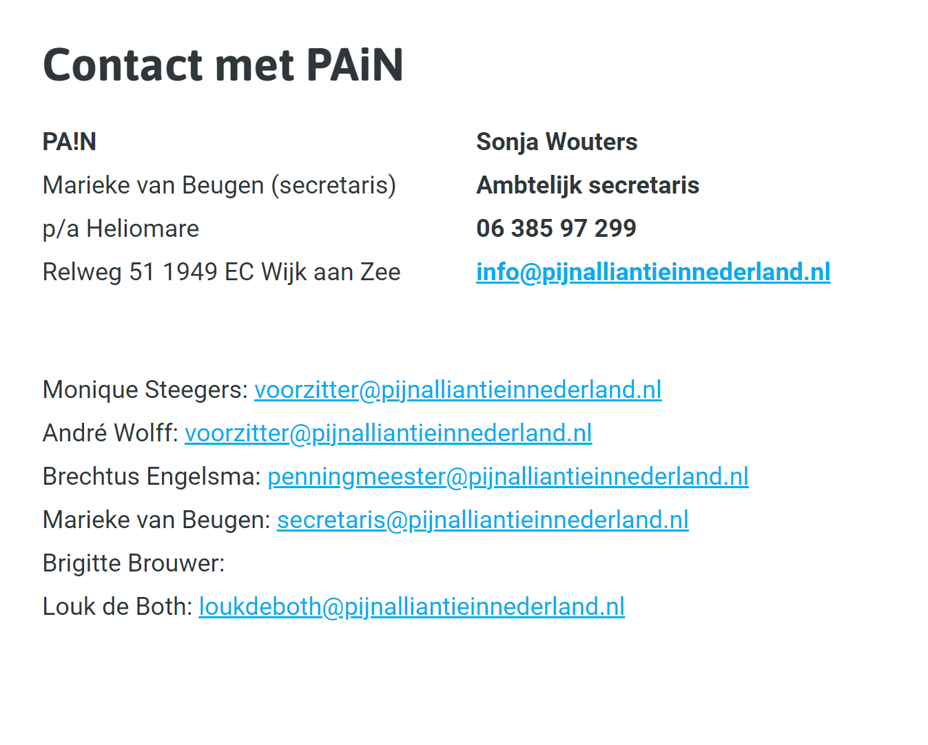
[Pain Alliance in the Netherlands]

Slide 74


We are ready to welcome you in 2027!
EFIC 2027: we go beyond boundaries for you
Notes:
74

Slide 75
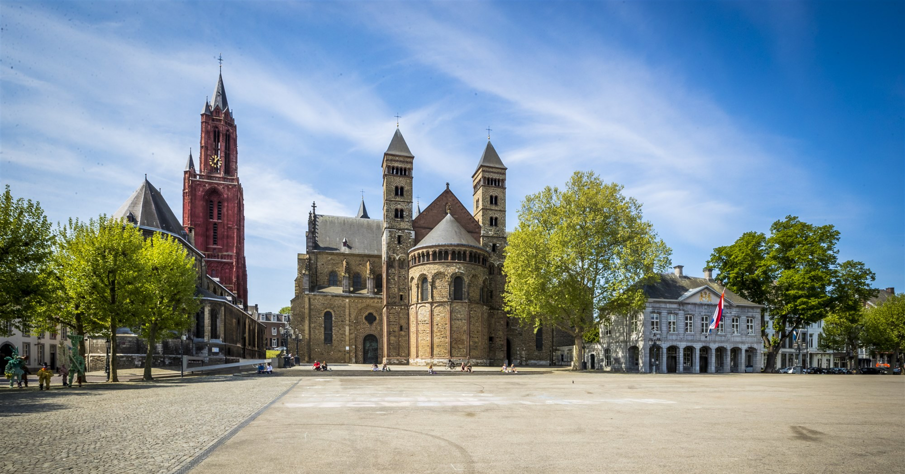
Cast your vote for MAASTRICHT
Your destination for the Congress Pain in Europe XIV in 2027
Conference beyond boundaries and experience
cross-border synergy in the heart of Europe!
EFIC 2027: we go beyond boundaries for you
Notes:
75

Slide 76

SIP National Platform Meeting
16.10.2024
Liisa Jutila
Finnish Pain Association

Slide 77
2024
Parliament's Pain and Migraine Task Force oncoing – Finnish Musculoskeletal association, The Finnish Migraine Association and Finnish Pain Association are part of it
ICD-11 is a project managed by the Finnish National Institute for Health and Welfare. Translation and other basic work is currently underway
Lots of contacts with healthcare and politicians – Finnish decision makers, politicians and institutes are easy to access
Regional elections in November - results also influence regional health priorities
No webinar this year - funding application for next year under way

Slide 78
2025
Parliament's Pain and Migraine Task Force continues
The Department of Health and Welfare's ICD-11 project should be ready by the end of the year. The project has been in constant contact and a friendly reminder has been passed on to them of the wish that the SIP organisations are available to work through the pain section. The work should be completed by the end of the year and ICD-11 should be implemented on 1 January 2026.
The book of evidence – open possibilities with healthcare professionals, politicians and institutes
Seminar in autumn – aim to organize event onsite, funding application underway (approx. 18 thousand)

Slide 79
FUTURE
Suomen Kipu ry
Suomen Kivuntutkimusyhdistys ry
Tuki- ja liikuntaelinliitto ry (TULE ry)
Suomen selkäliitto ry
Suomen Migreeniyhdistys ry
Suomen Liisa Jutila
liisa.jutila@suomenkipu.fi
Suomen Kipu ry (Finnish Pain Association)

Slide 80

Reflection on the New EU Health Policy Agenda
What do we know so far?
2024-2029 Political Guidelines and Health Mission Letter Published:
  ’Painkillers’ reference and access to most advanced treatments in Political Guidelines: New Critical Medicines Act to reduce dependencies on ingredients and critical medicines.
  Preventative health: Comprehensive approach to health promotion and diseases prevention.
    Investment in preventative measures to alleviate the burden of NCD’s.
  Continuation of the Beating Cancer Plan (BCP).
  Unified strategy for other health issues building on the BCP Framework: Cardiovascular diseases, mental health, etc.
  European Health Data Space implementation.

Slide 81
Proposed Priorities and Action Plan for SIP
Engage with EU Commission Ursula von der Leyen, Health Commissioners and Policymakers on access to pain treatment.
Monitor and support the European Health Data Space implementation – Developing a common approach with other areas positively affected by ICD-11 (i.e. Dermatology, Neurology, Immunology and Allergens, Rare Diseases).
Training and support for SIP National Platforms on different advocacy topics and priorities (i.e. advocacy toolkit; SIP Book of Evidence).
Monitor new policies, particularly on Mental Health.

Slide 82
Case Studies:
European Cancer Organisation – Richard Price
European Society of Cardiology – James Kennedy

Slide 83


Reflections on the EU Health Policy agenda: cancer perspective
Richard Price, Head of Policy, European Cancer Organisation.

Slide 84
About the European Cancer Organisation
₄₂ ₂₁ Patient Advocacy Groups
Member Societies
Working together to build consensus and achieve improvement
in cancer care
To reduce the burden of cancer, improve outcomes and the quality of care for cancer patients, through multidisciplinarity and multiprofessionalism
2
Notes:
Presenter
2024-11-05 17:29:30
--------------------------------------------
Firstly, a quick primer on who the European Cancer Organisation is, so you understand a little bit more where we are coming from on all this.
The European Cancer Organisation is an umbrella federation of 42, primarily healthcare professional organisations, supported by 21 patient advocacy organisations, set up in the early 1980s with a founding mission we remain true to which is….
…and that really speaks to what we do on HPV cancer elimination. It involves a wide range of oncology professionals to make it happen, but the goal, which is reachable, brings us all together.

Slide 85










































Our member societies
3

Slide 86





















Our Patient Advisory Committee
4

Slide 87




Our 3 strategic pillars of activity
Convening and Facilitating
Policy and Advocacy
Implementing & Delivering
The federation of the European cancer community - amplifying the important work of our member societies and Patient Advisory Committee.
Convening our Member Societies, patient groups and other stakeholders, building consensus, focusing on improved outcomes and benchmarking best practice.
We strive to be a leading organisation in the development of cancer policy at the European level.
We are available as a resource to European institutions to convene and facilitate across disciplines, professions and with patient advocates.
Supporting the implementation of Europe’s Beating Cancer Plan and Cancer Mission.
Coordinating and participating in EU Projects.
Coordinating projects for
our Focused Topic Networks.
5

Slide 88









Focused Topic Networks
6

Slide 89


7

Slide 90

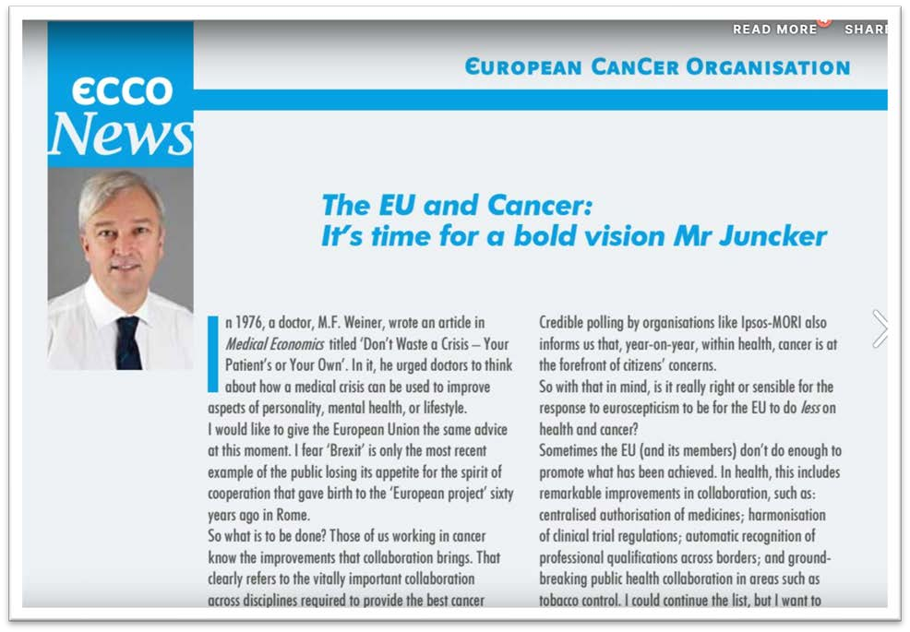

Promoting a vision of what Europe can achieve on cancer together: a journey to realisation
8

Slide 91
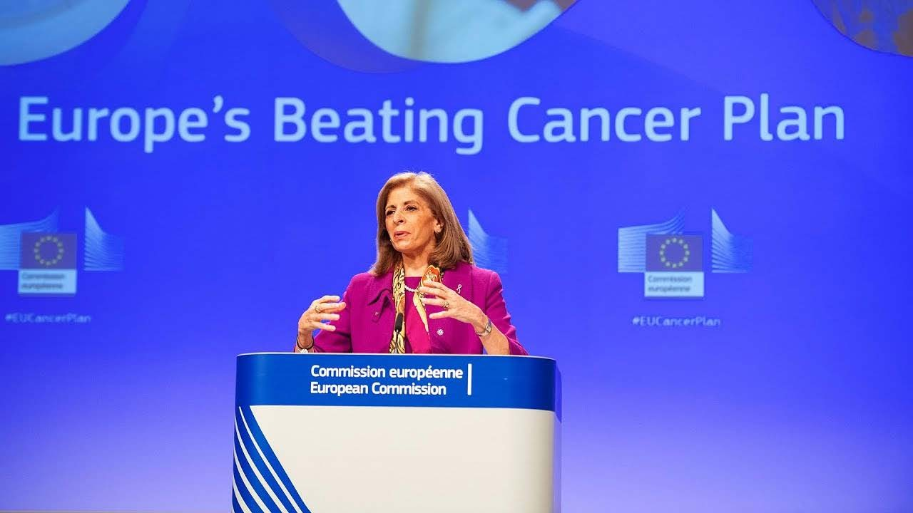
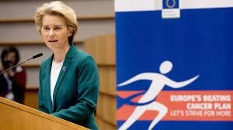
2019: Commitment to that vision from the top of the EU
9

Slide 92

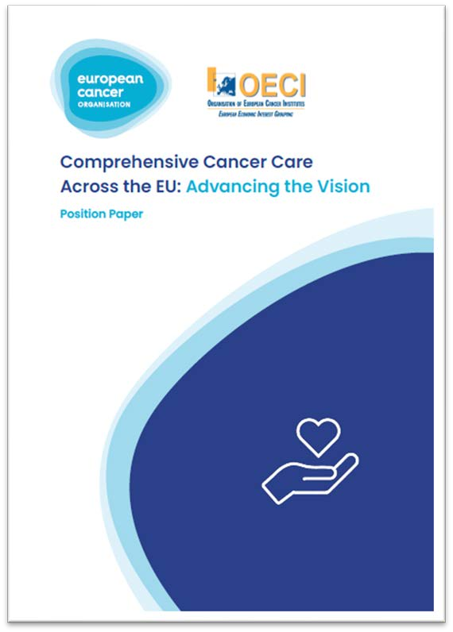

Speaking as one to the European Union
10

Slide 93







Free From Cancer’s 7 Asks
Take action on cancer distress
Elevate management of pain and other symptoms
Recognise Sexuality in Health System Approaches
Meet the Comorbidities Challenge
Empower patients and survivors: Education & Information
The Right to Reintegration into the Workplace
The “Right to Be Forgotten”
11

Slide 94
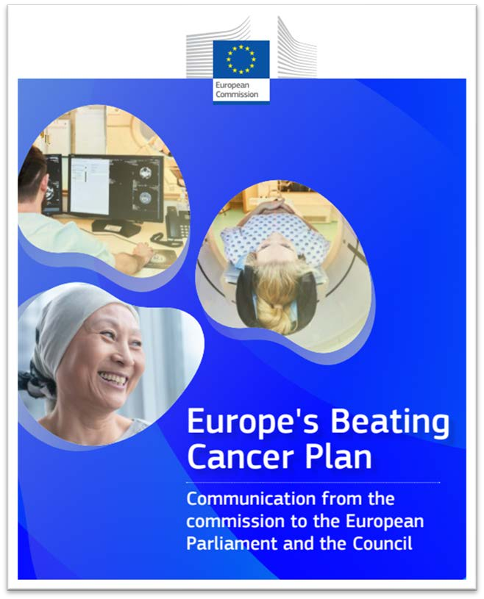
February 2021: the Plan’s publication
Jointly launched by European Commission President Ursula von der Leyen and EU Commissioner for Health and Food Safety Stella Kyriakides.
To be implemented using the whole range of Commission funding instruments, with a total of €4 billion being earmarked for actions addressing cancer, including from the EU4Health programme, Horizon Europe and the Digital Europe programme.

Slide 95

Key goals of Europe’s Beating Cancer
Plan include:
Eliminate cervical cancer and other cancers caused by human papillomaviruses
Create a ‘Tobacco-Free Generation’ where less than 5% of the population uses tobacco by 2040, compared to around 25% today
Ensure that 90% of the EU population who qualify for breast, cervical and colorectal cancer screenings are offered screening by 2025
Ensure that 90% of eligible patients have access to comprehensive cancer care by 2030

Slide 96





The Beating Cancer Plan’s Flagship initiatives 2021-2025
Prevention
Eliminate cancers caused by human papillomaviruses (by 2030)
Early detection
Develop a new EU Cancer Screening Scheme
Diagnosis & treatment
Establish an EU Network of National Comprehensive Cancer Centres
Launch ‘Cancer Diagnostic and Treatment for All’
Launch UNCAN.eu to help identify individuals at high risk for common cancers
2021 2022 2023 2024 2025
Quality of life
Launch the ‘Better Life for Cancer Patients Initiative’
Cross pillar objectives & initiatives
Create a Knowledge Centre on Cancer
Launch an EU Cancer Imaging Initiative
Launch a Cancer Inequalities Registry
Launch the ‘Helping Children with Cancer Initiative’
14

Slide 97














A Plan that is coming alive: through projects
15

Slide 98
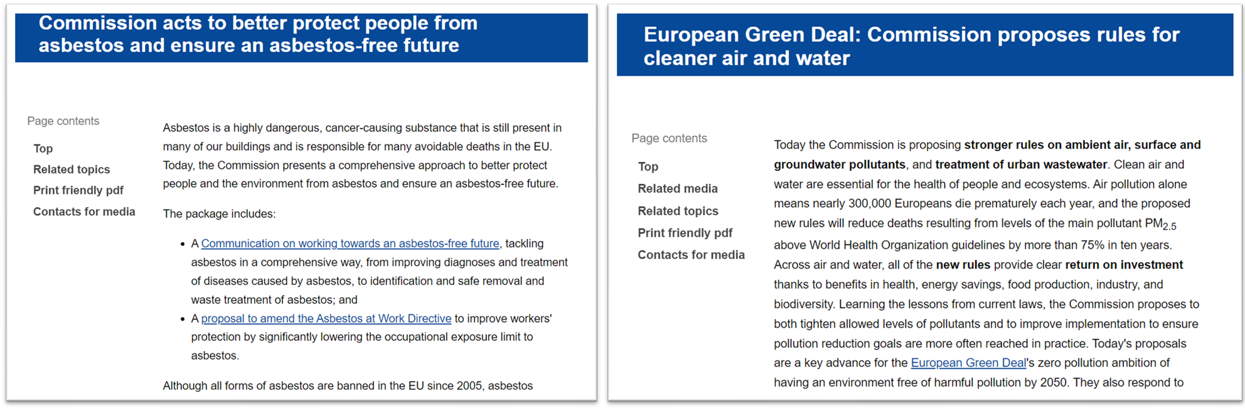
A Plan that is coming alive: through legislation

Slide 99

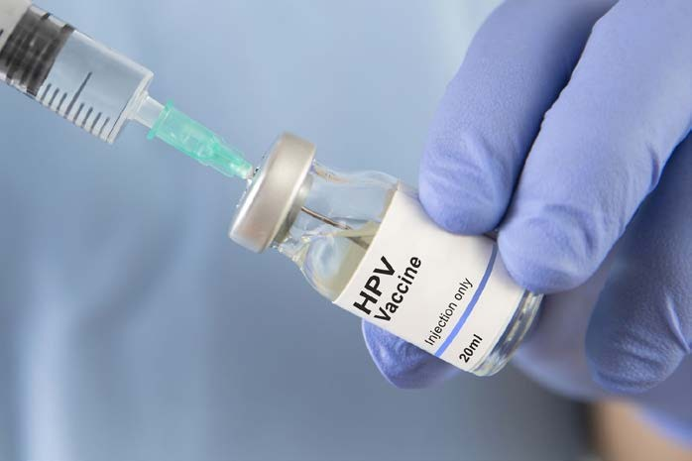

A Plan that is coming alive: through national action
17

Slide 100

Foundations laid, communities of cooperation created, but a job still to be finished...
18

Slide 101

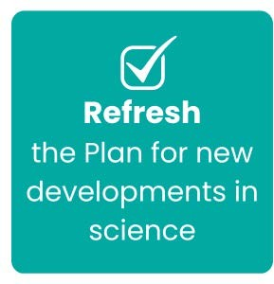

Go further, faster and together
19

Slide 102
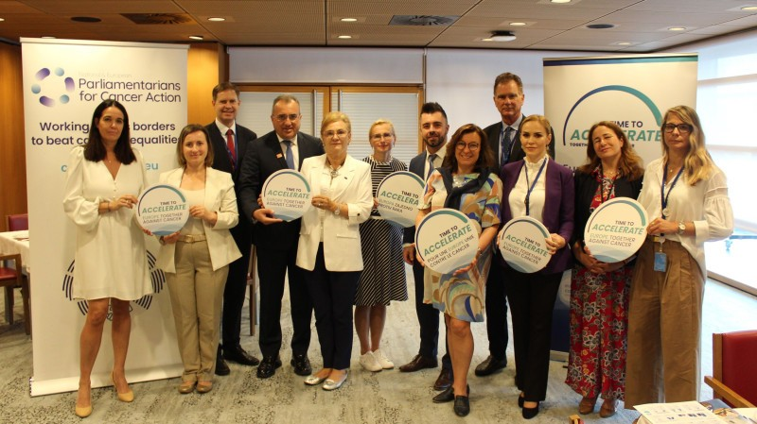
20

Slide 103
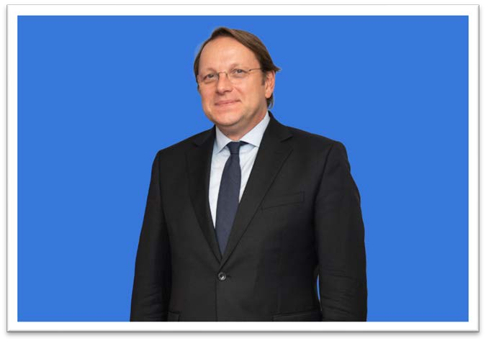
Instructions to the Commissioner designate
I would like you to ensure the implementation of the European Cancer Plan.
You should draw on this work to design a common approach in other areas, looking in particular at mental health, cardiovascular diseases, degenerative illnesses, autism and other non-communicable diseases.
The mission letter from European Commission President Ursula von der Leyen to the Commissioner Designate for Health and Animal Safety, Olivér Várhelyi
21
Notes:
Presenter
2024-11-05 17:30:10
--------------------------------------------
The venue will be the same as the previous edition, in the city centre of Brussels. While adding a more digital touch to the Summit, The LED screen will bring more flexibility in presenting content and will help saving time and costs in changing stagings for the smartCARE and PROTECT-EUROPE showcase event on Friday.

Slide 104

Building the world after 2027…
•
EU health policy success should be reinforced.
•
Science, practice and technology have moved on at pace. A refresh of the Cancer Plan is required.
•
New goals will drive further success, reinforcing the EU’s added value in driving cross-border action.
22

Slide 105
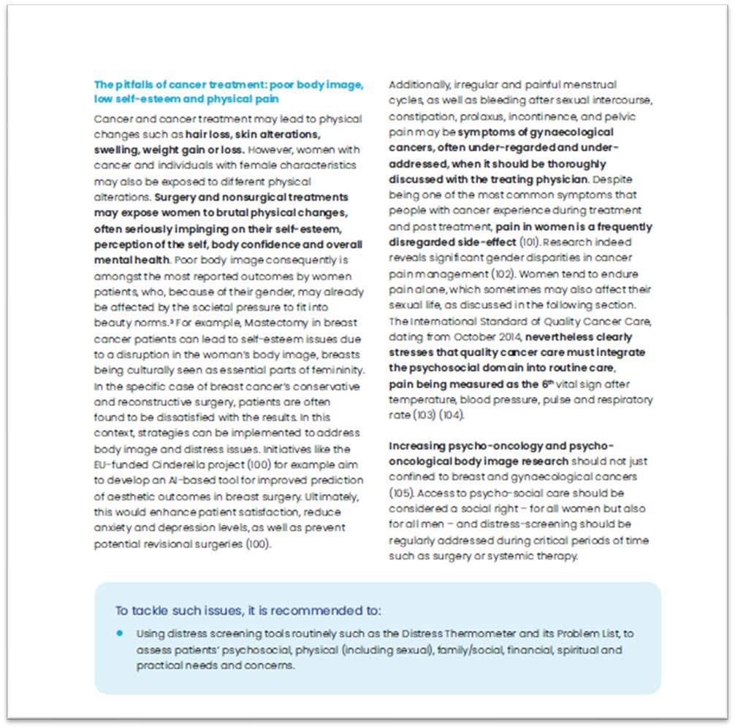

Coming soon
23

Slide 106
ESC Advocacy Case Study
James Kennedy 15.10.2024

Slide 107
What we wanted
Set the stage for an EU Cardiovascular Health Plan that can serve as a model for all governments and ensure sustainable funding for research, infrastructure, and health workers.
To make this a reality, two action lines are proposed:
Cardiovascular Health in all policies | Cardio-Policy
Create an understanding that the impact of cardiovascular health is felt in all aspects of our lives and so must be seen in all aspects of policy. | Build a lasting network of national cardiac societies capable of influencing local and EU policy makers to the benefit of patients and ESC members.

Slide 108

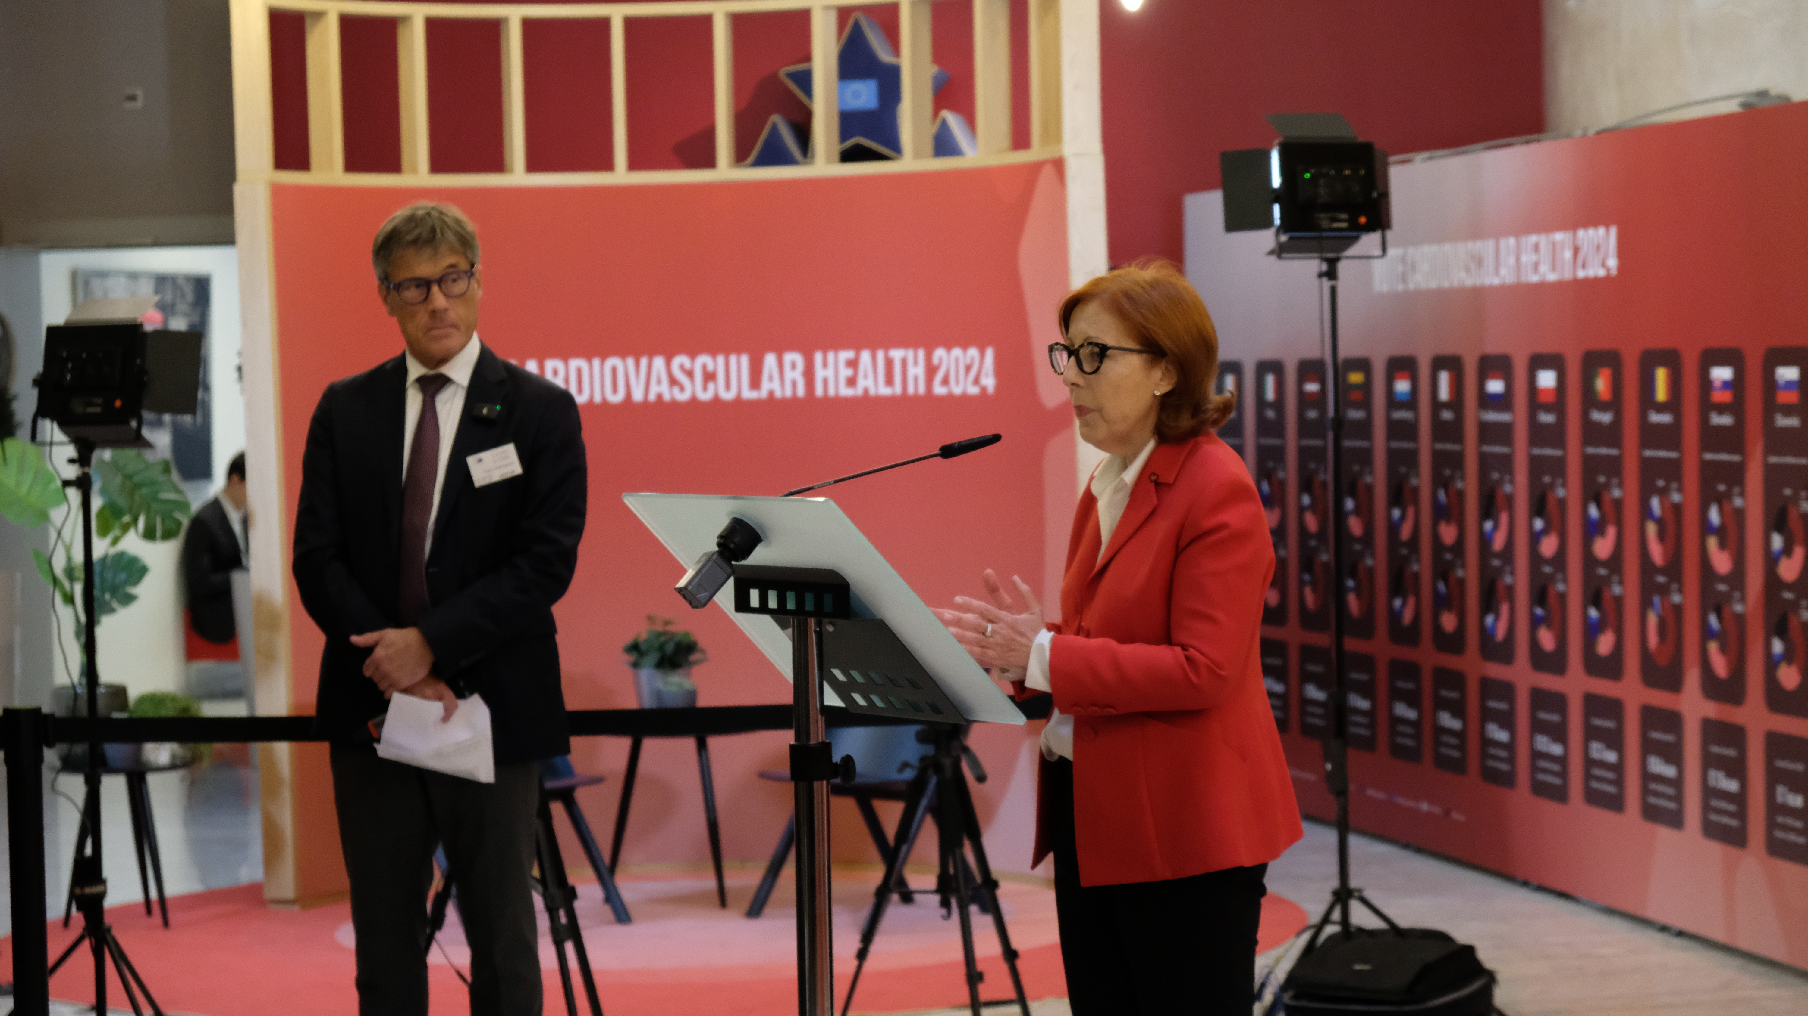

Where we stand after 3 years of campaigning
Vote Cardiovascular Health 2024
High level Ministerial conference on Cardiovascular health
CVH an EU Council Priority for the first time in 20 years
Largest ever exhibition on CVD in the European Parliament 11-14 December
Event secured CVH on EPP manifesto;
3-4 July 2024 event in Budapest
ESC-EU Presidency Paper "Improving Cardiovascular Health in Europe: the case for EU and national plans”
Council Conclusions on CVD in December

Slide 109
How we go there
Embrace different reasons for the same outcome;
Deploy Alliances/Membership;
Make your issues something policy makers can run on;
Be helpful.

Slide 110
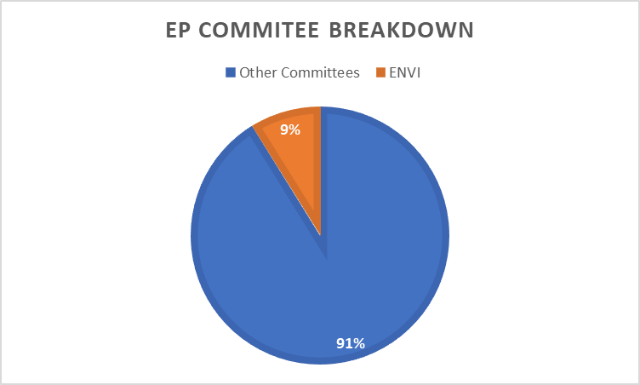
Embrace different reasons for the same outcome
Why we need to widen our scope
Only a fraction of Members of the European Parliament are interested in healthcare for its own sake (ENVI Committee);
For the 91% of the rest – we need to tie CVD to their direct areas of interest eg:
  Air pollution;
  Employment;
  Research;
  Civil Liberties/Rights;
  Gender and social equality;
Widening our allies base should not mean losing sight of our goal or diluting our efforts – merely placing CVD in their area of interest!

Slide 111
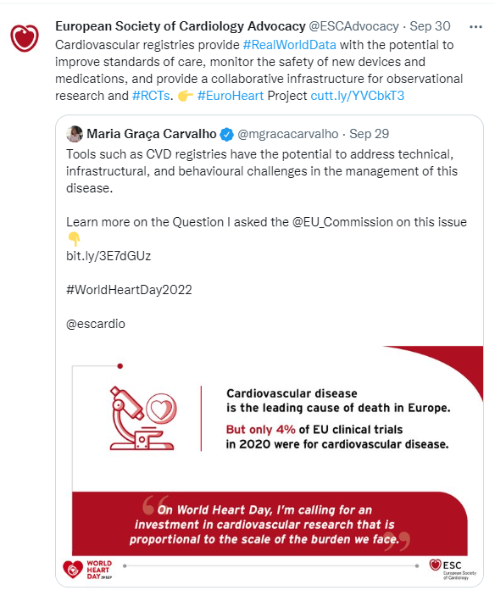
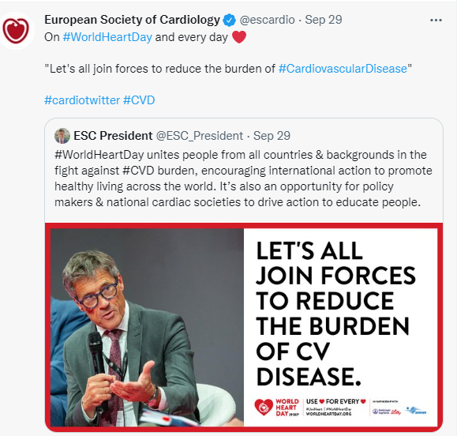
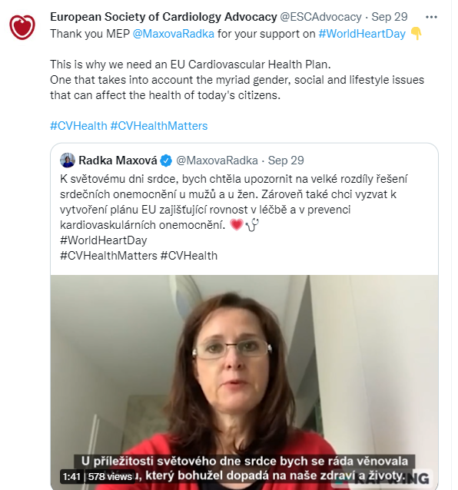
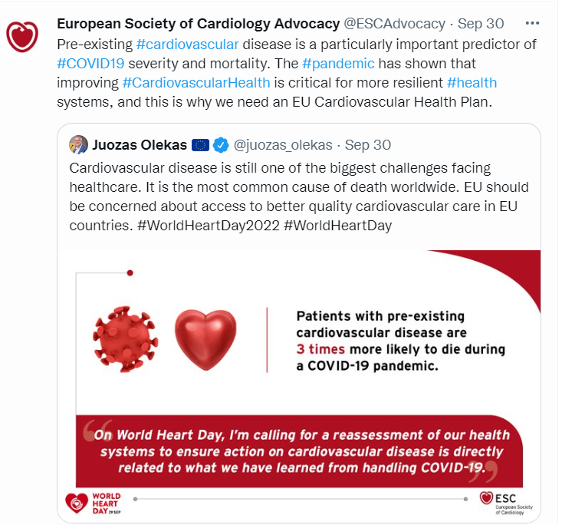
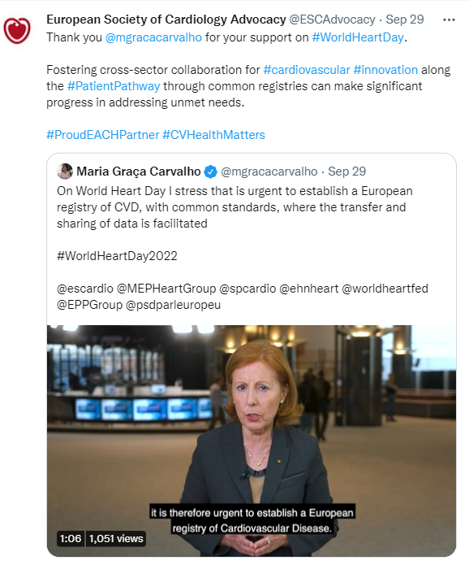
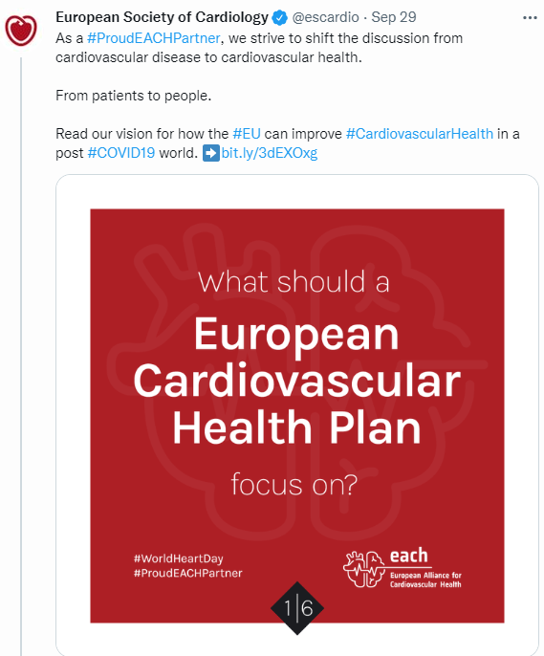
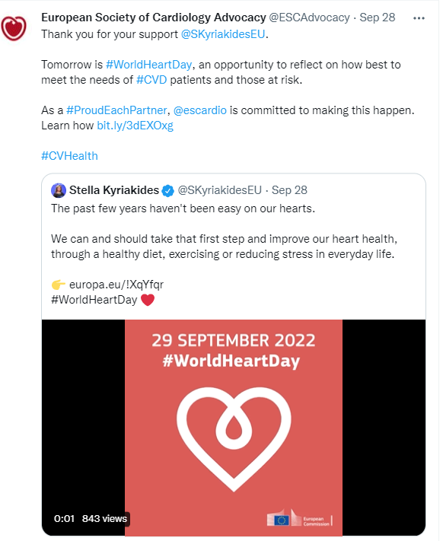
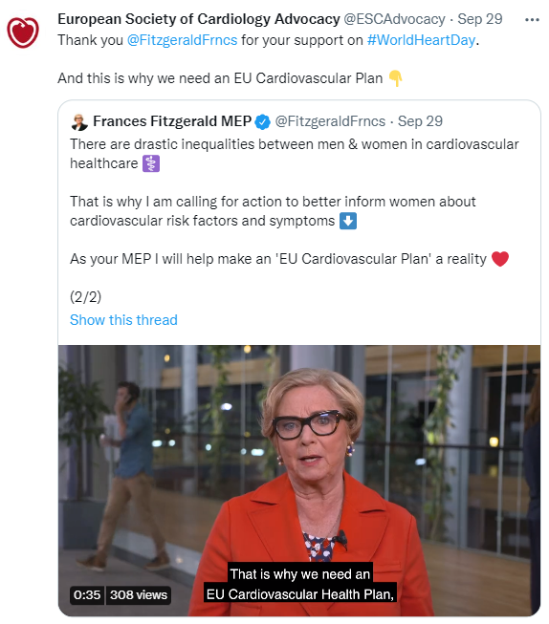
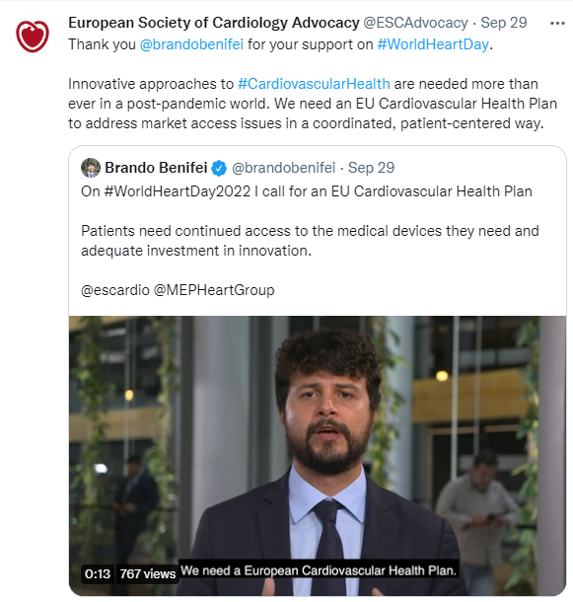
World Heart Day ‘22: “….and that’s why we need an EU CVH Plan”

Slide 112





Deploy Alliances – EACH/Membership
European Alliance for Cardiovascular Health (EACH) - largest EU group of stakeholders in cardiovascular health ever brought together under one banner.
EACH plan endorsed by all 17 members of the Alliance – patients organisations, clinical societies and industry groups.
Calls for:
  National CVH Action Plans;
  Data Knowledge centre;
  Cardiovascular Health Checks;
  Primary prevention and early intervention.

Slide 113





Make your issues something they can run on
ESC RV
Exhibition showcasing x27 individual
CV profiles of the Member States
Goal is to provide a platform for MEPs and political groups to make clear public commitments to CVH in their election manifestos
THEY post, you repost
Interviews by EACH members with MEPs in their own languages
Photos of MEPs with their country’s exhibit
Social media pack for MEPs and EACH members to use.
Event itself!
87 videos recorded, 100 signatures, EPP Commitment secured

Slide 114



Be helpful

Slide 115
Challenges ahead
Prevention policy – going beyond position papers;
Resistance to disease specific plans/dilution of plans;
Smaller budget, greater needs.

Slide 116









Europe Region of
World Physiotherapy & Its Work
Regarding the EU Health Agenda
SIP Stakeholder Forum – 16/10/2024
Miguel Pérez Navarro | Comm. & Ops. Officer
Emilia Kosińska | Projects Manager
secretariat@erwcpt.eu
projectsmanager@erwcpt.eu
https://www.erwcpt.eu/
@ERWorldPhysio
@erworldphysiotherapy
Europe Region
World Physiotherapy

Slide 117



INDEX
  What is the Europe Region of World Physiotherapy?
  Strategic Plan 2022-2026
  Actions regarding the EU Health Agenda
  EU Projects – Focus in 2025

Slide 118



What is the Europe Region of World Physiotherapy?
1951
Africa Region
South America Region
North America Caribbean Region
Europe Region
Asia Western Pacific Region
128 Member Organisations
685 000 Physiotherapists

Slide 119



What is the Europe Region of World Physiotherapy?
1998
30 MOs
The voice of physiotherapy to the European and EU authorities
Non-profit, non-governmental, organisation funded by Member Organisations (MOs) subscription fees
Office and secretariat in Brussels
38 Member Organisations
200 000 Physiotherapists

Slide 120


Strategic Plan 2022-2026
Vision
Enabling people in Europe to live active healthy lives.
Leading, promoting and representing the profession in the Region by driving excellence in education, practice and research, advocating and influencing health policy.
Purpose
  Demonstrate the value and impact of Physiotherapy
  Physiotherapists are recognised as autonomous professionals
  Promote excellence in Physiotherapy education, practice and research
  Engage in relevant policy development at EU and national level
Strategic
Objectives

Slide 121

















Strategic Plan 2022-2026
Executive Committee
Secretariat
Working Groups
Advocacy & EU Matters
Education &
Research
Professional Practice
Esther-Mary D’Arcy
Aitor Carpio García
Chair
General Secretary
Carmen Suárez Serrano
Tim Németh
1st Vice-Chair
2nd Vice-Chair
Mental Health
Cancer
Emilia Kosińska
Miguel Pérez Navarro
Projects Manager
Communication & Operations Officer
Musculoskeletal Disorders
Katri Partanen
Michele Cannone
EC Member
EC Member

Slide 122

EU Health Agenda
Cancer
Mental Health
Prevention

Slide 123

EU Health Agenda
Guidelines | Physiotherapy Entry-Level Competencies in Cancer
Webinar | The Role of Physiotherapy in Cancer Care for Adolescents and Young Adults
Infographics | To increase awareness
Keeping in close relation with cancer stakeholders
erwcpt.eu/cancer
Notes:
Enhance the promotion, recognition and impact of the profession in the Europe Region through focusing on the theme of Cancer and the role of physiotherapy in Cancer care.

Slide 124

EU Health Agenda
Briefing Paper | Harnessing Physiotherapy Skills for Mental Health Solutions: Call for Action
Webinar | The Role of Physiotherapy in Mental Health
erwcpt.eu/mental-health
Notes:
Enhance the promotion, recognition and impact of the profession in the Europe Region through focusing on the theme of Mental Health and the role of physiotherapy in Mental Health from the perspectives of education and research, professional practice, and advocacy and the EU.
The Working Group identified that the main focus would be to raise awareness on what is physiotherapy in mental health and what impact physiotherapy has on mental health.

Slide 125
EU Health Agenda
Non-Communicable Diseases
Document | The Role of Physiotherapy in NCDs
- 20 November 2024: Event in Budapest under the auspice of the Hungarian Presidency of the EU Council

Slide 126
EU Health Agenda
Ongoing Projects
Finalising the UcanACT project (Erasmus+) by the end of Q2 2025 - cancer prevention
PROMINENCE project - ending in Q1 2026 - obesity education (prevention)
Notes:
At the Europe Region, we continue to focus on the cancer, mental health, and prevention areas. Currently, the Europe Region is involved in 2 EU-funded projects, UcanACT and PROMINENCE.

Slide 127


UcanACT Project
Notes:
Currently, the flagship project is UcanACT, where the Europe Region is the project’s coordinator. There are 7 partners in addition to the Europe Region, from 4 EU countries, so altogether it’s an 8-partner partnership in 5 countries. In addition to the Consortium, we also have the participation of various local organisations.

Slide 128





UcanACT Project
  UcanACT - coordinated by the Europe Region - joins physiotherapists, local authorities, a patient organisation, higher education and research institutions with the overall objective: to engage adults 50+ in physical activity as a tool for cancer prevention within public urban green spaces.
PUGS
Notes:
The main goal of UcanACT is to engage adults aged 50 and over in 3 pilot territories - Bologna, Kilkenny, and Munich - in cancer-preventive physical activity with the leadership of physiotherapists who deliver the twice weekly sessions outdoors, using the parks and urban green areas - so called PUGS - as the location for the group sessions. To make it happen, our pilot territory partners need to engage with local authorities and other stakeholders to secure the locations, advertise the physical activity sessions to our target group in the local area, and recruit physiotherapists willing to participate and commit to 2 pilot rounds.

Slide 129

UcanACT Project
  Deliverables:
New Practical Intervention Methodology on delivering physical activity (PA) exercises for cancer prevention for adult and senior citizens within public urban green spaces;
Massive open online course for physiotherapists and other health professionals - MOOC;
UcanACT App;
Citizen Engagement Strategy for implementation of Pilot cancer-preventive physical activity;
Research on economic value and cost effectiveness of PA cancer-preventive measures.
Visit the UcanACT website
and subscribe to the Newsletter
Notes:
In addition to the already mentioned physical activity sessions, UcanACT also produced the PIM, based on literature review of best practices, showcasing PTs how to deliver the PA for older adults, accompanying MOOC for physiotherapists and sports professionals to verify their knowledge and readiness for UcanACT, an App for both PTs and participants that enables participants to practice PA unattended in their own time. The consortium also created the CES to ensure a smooth organisation in approaching participants.

Slide 130




PROMINENCE Project
Notes:
The PROMINENCE project combines 6 partners from 4 EU countries, and the Europe Region is one of the partners in the project. PROMINENCE aims to introduce obesity education for entry-level physiotherapy curricula, thus educate physiotherapists on how to help patients living with obesity, also with the hopes of further NCDs prevention.

Slide 131

PROMINENCE Project
Visit the PROMINENCE website
and follow us on social media!
  PROMINENCE: Promoting Obesity and Metabolic Rehabilitation INclusion in EU Entry-level Physiotherapy Curricula - a 28-month project that started in January 2024 - focuses on physiotherapy education regarding obesity.
Main deliverable:
Open Education Resource Design and Production - Europe Region leading the Work Package
The Europe Region of World Physiotherapy is also heavily involved in Capacity Building, Communication, Dissemination, and Implementation stage.
Notes:
The Europe Region will design and produce the Open Education Resource, once the scoping review and curriculum analysis in the European region is fully conducted. The OER will be free of charge and available online for both physiotherapy students, physiotherapy lecturers, and those in the physiotherapy area who wish to re-visit obesity approach within the physiotherapy practice. Europe Region also facilitated the survey regarding the current state of and any gaps in obesity education at the university level in the European region that will inform the OER’s content.

Slide 132
EU Health Agenda
2025 Plans for Future Projects
Cancer & Physiotherapy Master’s Curriculum (EMDM Erasmus+ tool)
Uni4Move - reapplication (Erasmus+) - physical activity and mental health management for university students & staff
Mental Health & Prevention - building a proposal focusing on mental health and NCDs prevention through physical activity in the young population (EU4Health)
Notes:
In relation to the EU Agenda, ERWP’s focus remains with the three main areas that we include in our work: cancer, mental health, and prevention of NCDs. For 2025, we’re planning to apply for 3 EU funded projects that cover these areas, so keep your fingers crossed.

Slide 133

THANK YOU!
Miguel Pérez Navarro | Comm. & Ops. Officer
Emilia Kosińska | Projects Manager
secretariat@erwcpt.eu
projectsmanager@erwcpt.eu
https://www.erwcpt.eu/
@ERWorldPhysio
@erworldphysiotherapy
Europe Region
World Physiotherapy

Slide 134
How are our Partners in the Room Approaching the New EU Mandate?

Slide 135
Closure & Thank You
SIP Stakeholder Forum

