Slide 1
European Day on Pain Awareness 2025
“Preventive Healthcare for Chronic Pain”

Slide 2

Preventing Chronic Pain – Why it matters now?
🔹 Logo of EFIC National Chapter
🔹 Date & location of the event
🔹 Speakers names

Slide 3
What is Chronic Pain?
Chronic pain is defined as pain persisting for longer than three months
It affects 1 in 5 adults in Europe, making it the most prevalent reason for seeking healthcare and the leading cause of disability and reduced quality of life.
Chronic pain encompasses various conditions—including low back pain, headaches, arthritis, postsurgical pain, and neuropathic pain
It is a multidimensional health condition, shaped by biological, psychological, and social factors. Its burden is amplified by stigma, inadequate assessment, and systemic neglect .
“Chronic pain is not just a symptom—it's a complex health condition in its own right”
Chronic pain impacts:
🔹 Quality of life
🔹 Mental health
🔹 Work and education
🔹 Social participation

Slide 4
Why Prevention Matters
Chronic pain is preventable in many cases
It is linked to:
🔹 Physical inactivity
🔹 Poor sleep
🔹 Stress, fear of movement
🔹 Unsafe working conditions
🔹 Mental health conditions
Economic burden: up to €12 billion/year in Europe
Prevention reduces:
🔹 Disability and health costs
🔹 Unemployment
“Early action improves outcomes for individuals and society”

Slide 5

What Prevention Looks Like
🔹Public awareness on what pain is and isn’t
🔹 Exercise and education programmes in clinics and communities
🔹 Early biopsychosocial support for those at risk
🔹 Evidence-based acute care (avoid low-value interventions)
🔹 Workplace support and flexibility
🔹 Vaccination for certain pain-causing diseases (e.g. shingles)
“Prevention is possible, affordable, and effective”

Slide 6

Who Has a Role to Play?
🔹 Professionals
Detect early signs of pain and risk
Offer conservative care and movement-based solutions
Educate patients on coping and recovery
🔹 Patients & the General Public
Understand pain and seek help early
Stay active and informed
Speak up—your voice shapes policy
🔹 Policymakers
Fund prevention and awareness
Include chronic pain in national health plans
Support research and primary care systems

Slide 7
Taking Action in Your Country
🔹 Recognise chronic pain as a preventable condition
🔹 Invest in public campaigns and workplace programmes
🔹 Include pain in your country’s prevention, ageing and NCD strategies
🔹 Support adoption of ICD-11 and digital pain tools
🔹 Collaborate with national SIP platforms and pain organisations
Together, we can prevent pain before it becomes a lifelong burden.

Slide 8
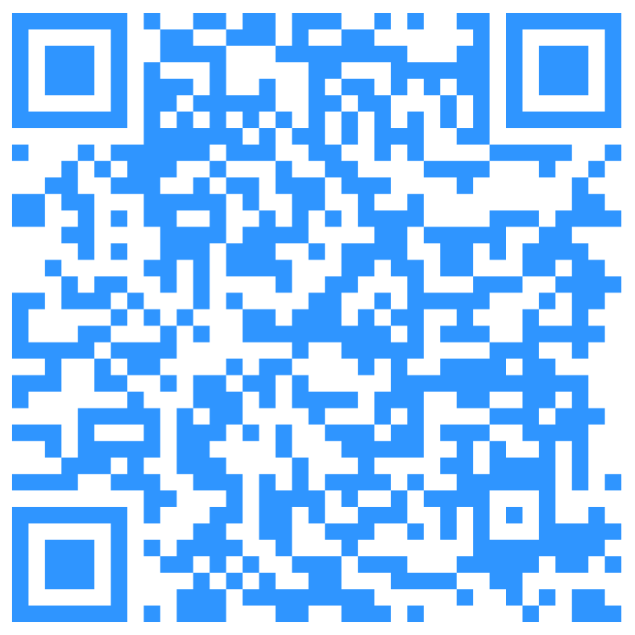
Join the Campaign
European Day on Pain Awareness – 2025 Theme: Prevention
🔹 Learn more: Scan the QR code!
🔹 Contact: melinda.Borzsak@efic.org and angela.palomares@efic.org
🔹 Hashtags: #PainAwareness #PreventPain #TogetherToRelievePain
“Let’s act early. Let’s act together”

Slide 9
Thank you!

