Slide 1




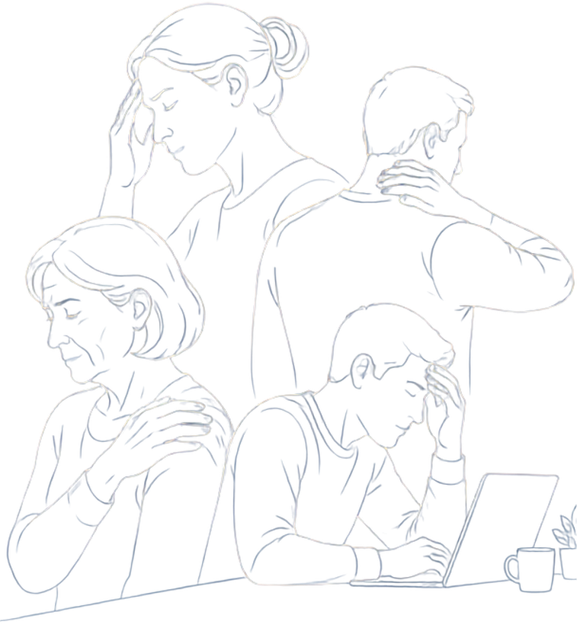


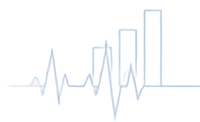




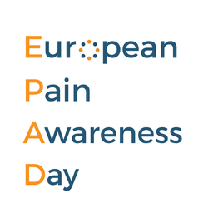
LOGO OF NATIONAL CHAPTER
European Pain Awareness Day 2026
THE HIDDEN COST OF PAIN
DATE
LOCATION
SPEAKER(S)

Slide 2











What is Chronic Pain?
1
in 5
adults in Europe
lives with chronic pain.
Persists longer than 3 months
A leading cause of disability
Common chronic pain conditions include:
Headaches
Neuropathicpain
Post-surgical pain
Low back pain
Arthritis
Chronic pain is not just a symptom—
it’s a complex health condition in its own right

Slide 3



The Hidden Costs of Chronic Pain
150 million
3-10% of GDP
1 in 2 people
Europeans live
with chronic pain
lost annually
say pain affects their ability to work
through healthcare costs, absenteeism, presenteeism, and early retirement
severe pain can reduce
the likelihood of full-time employment by up to
20 percentage points
20% of the adult population

Slide 4
















Pain affects more than health.
Quality of life
Mental
well-being
Work
Education
Social participation
Other aspects of life
It affects Europe’s economy.
Workforce participation
Productivity
Healthcare systems
Economic growth

Slide 5








Everyone Has a Role to Play
Reducing the burden of chronic pain requires action from all of us.
PROFESSIONALS
PATIENTS &
THE PUBLIC
EMPLOYERS
& BUSINESS
POLICYMAKERS
Detect
Fund
early signs
of pain and risk
Understand
Create
prevention, awareness
and research
pain and
seek help early
supportive,
inclusive workplaces
Offer
Include
conservative care and
evidence-based solutions
Speak Up
Enable
chronic pain in national
health plans
because your
voice shapes policy
flexible work and
return-to-work support
Educate
Invest
Support
patients on coping
and recovery
Stay Active
in wellbeing
of your employees
research and primary
care systems
and informed

Slide 6






Taking Actions in Your Country
01
02
03
04
05
06
RECOGNISE
INVEST
INTEGRATE
ENHANCE
SUPPORT
COLLABORATE
chronic pain as a preventable condition
in public campaigns and workplace programmes
pain in your country’s prevention, ageing, and NCD strategies
pain management through the adoption of
ICD-11 and digital pain tools
workplace participation
with national SIP platforms and pain organisations
2
1
Early action improves outcomes for individuals and society.
1
NCDs = non-communicable diseases
2
ICD-11 = International Classification of Diseases 11th Revision

Slide 7
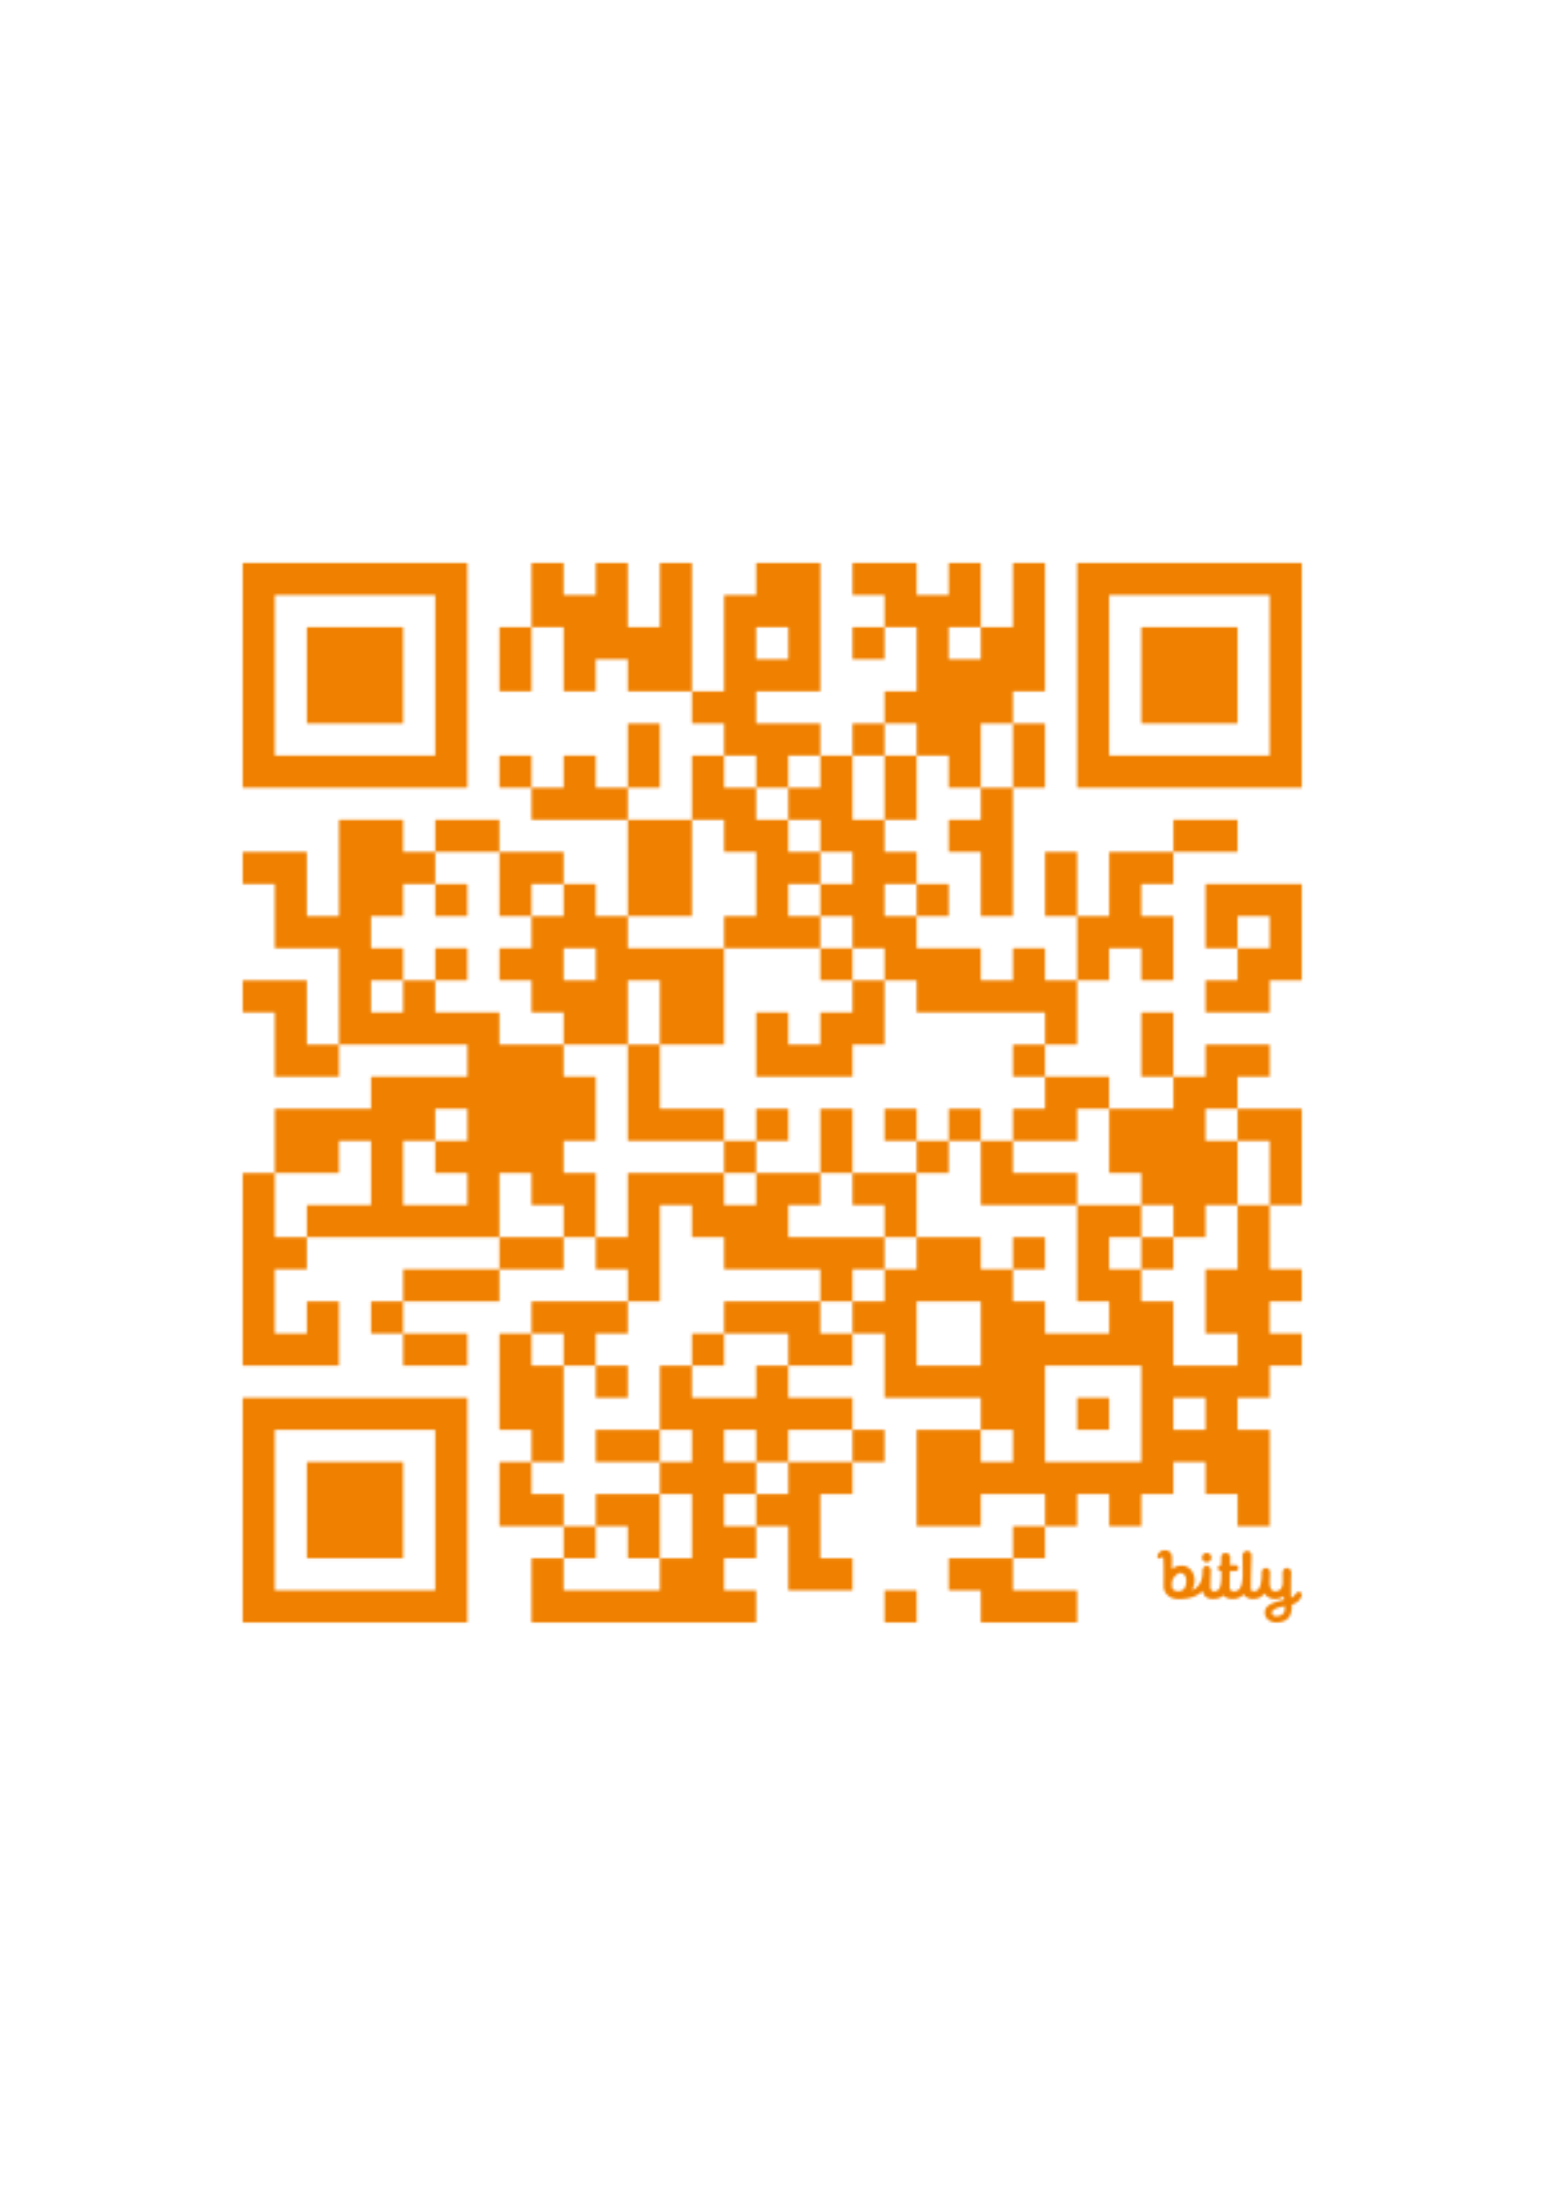





Join the Campaign
European Pain Awareness Day 2026
Theme: The Hidden Cost of Pain
?
Learn more
Scan the QR code
#
Share the message
#EPAD2026
Contact
melinda.borzsak@efic.org angela.palomares@efic.org
EF
C
EUROPEAN PAIN FEDERATION

Slide 8
LOGO OF NATIONAL CHAPTER
Thank you!

